Slide 1
Introduction to Molecular Phylogenetic Analyses
GDW 2017
Colorado State University
Slatteryjp@si.edu
Jill.Pecon.Slattery@gmail.com www.cornerstonegenomics.com

Slide 2
What Is Phylogenetic Analysis?
Phylogeny = Evolutionary history
Reconstruction of evolutionary history using shared traits among organisms
Tree of life (http://www.tolweb.org/tree/)
Phylogenetic reconstruction
Evolutionary model
Data
Morphological: phenotypic variation within traits, how to code, not all traits shared
Molecular Genetic: discrete, common to all life
Homologous: descended from a common ancestor
Resultant Tree
Topology
Structure of interconnecting nodes and branches
Internal nodes represent hypothetical common ancestors
Branch lengths
Estimates of divergence
Estimation of elapsed time between nodes of tree
Time since taxa last shared a common ancestor
Molecular Clock Hypothesis
Zuckerkandel and Pauling (1965):Molecules as Documents of Evolutionary History

Slide 3
Phylogenetic Tree
Phylogram
Tree branch length proportional to genetic divergence
Cladogram
Topology only, branching order important
Character data
Rooted
Outgroup
Midpoint rooting
Unrooted
Consensus tree:
Consensus of multiple trees obtained under same optimality criteria
Bootstrap, jackknife results
Tree Programs:
TreeView (website) http://taxonomy.zoology.gla.ac.uk/rod/treeview.html
FigTree (website) http://evolve.zoo.ox.ac.uk/software.html?id=figtree

Slide 4
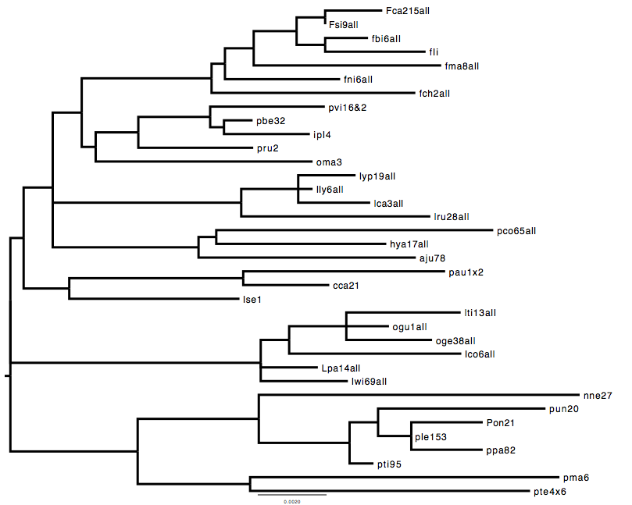
Midpoint Rooted Phylogram

Slide 5
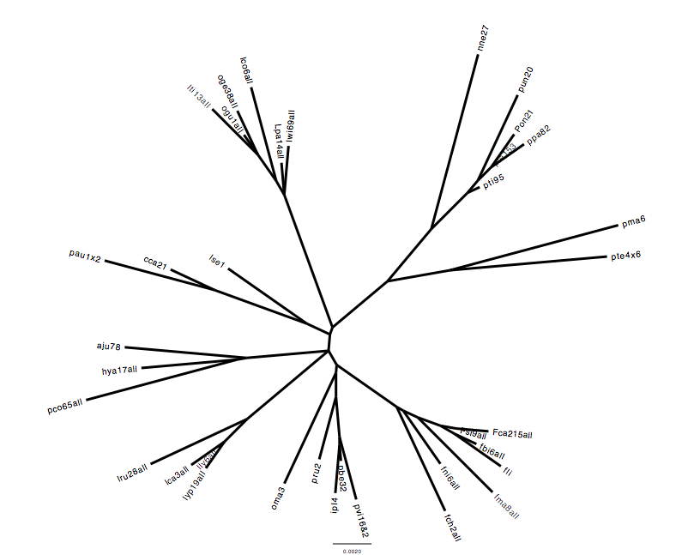
Unrooted Phylogram

Slide 6
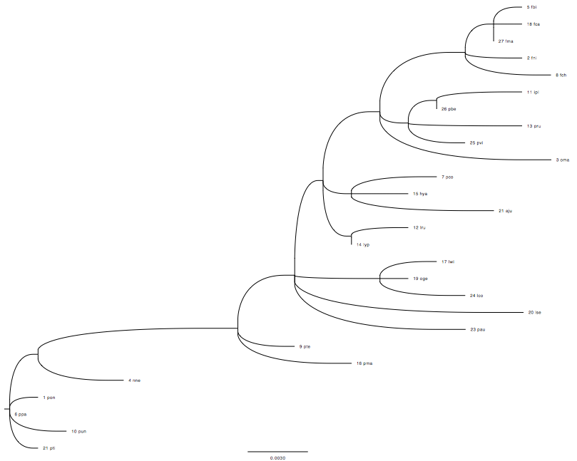
Cladogram

Slide 7
Basic Steps in Phylogenetic Analysis: Part 1
Step 1: Determination of informative marker
Rate of evolution “roughly” proportional to genetic divergence
Multiple markers
MtDNA, nuclear, sex linked
Step 2: Determination of sample size and design
Taxa
Outgroup-root
Step 3: Alignment (sequence data)
Step 4: Model of substitution
Nucleotide data
Among site rate heterogeneity
Bias Frequency Nucleotides
Transition: transversion
Codon analyses
Protein Data
Probability matrix [DAYHOFF, DCMUT, JTT, MTREV, WAG, RTREV, CPREV, VT, BLOSUM62, MTMAM, LG] or empirical frequencies of amino acid within data set.

Slide 8
Basic Steps in Phylogenetic Analysis: Part 2
Step 5. Reconstructing phylogenetic tree
Impose optimality criteria
Maximum Likelihood
Minimum Evolution (distance-based)
Maximum Parsimony
Bayesian Inference (MCMC)
Computer Programs
PAUP, MEGA, GARLI, RAxML, PhyML, MrBayes
Supercomputers ExaML, RAxML-light
whole vertebrate genomes (e.g. Bird phylogeny)
PartitionFinder
best-fit partitioning schemes and models of molecular evolution for phylogenetic methods
Step 6. A posteriori evaluation
Bootstrap
Assessment of tree reliability
Re-sampling with replacement
Node support
Jackknife
Random sampling without replacement
Sites or taxa
Bayesian Posterior Probability of model parameters

Slide 9
Categories of Markers Applied in Phylogenetics
Whole Genome Comparisons
Comparison of syntenic regions (Conserved Sequence Blocks)
Protein Coding Data
Homologs versus Paralogs
Gene duplication and Gene Loss
Amino Acid versus Nucleotide
Synonymous substitutions
Nonsynonymous substitutions (missense mutations)
MtDNA
Pattern of Inheritance Bias
Matrilineal
Single Evolutionary Unit despite different genes evolving at different rates
Autosomes, X & Y Chromosomes
Rates of evolution differ among chromosomes
Y/X > 1 Male-driven evolution linked with spermatogenesis
Retroelements
SINEs, Endogenous retroviruses,
Microsatellites, SNPs, SNVs

Slide 10
Selection of Appropriate Genetic Marker
Informative: “Garbage In, Garbage Out”
Relative time scale of comparison
Mammalian Evolution (130 MY)
Carnivore Evolution (40 MY)
Felidae Evolution (10 MY)
Phylogeography and Population Genetics of Cat Species (0.01-0.5 MY)
Domestic cat (6000 years ago)
Neutral Evolution: Does it exist?
First proposed by Kimura (1968): amino acid changes are selectively neutral driven by mutation rate and genetic drift.
Short answer : unlikely
Genomes and genes under strong selection
Maintain function (purifying selection)
Diversification to adapt or to gain function (positive selection)
Is this really a problem?
Phylogenetics still very useful tool to detect and describe
How many markers?
Robustness: Each additional marker strengthens overall topology
Accuracy: Markers reflect evolutionary and natural history
Precision: Markers evolve similarly throughout phylogeny
Empirical Consensus: Combined Data Optimal but Multi-species coalescence Approaches gaining in popularity
Notes:
Gene trees that support alternate phylogenies—gorilla paper
The multispecies coalescent (MSC) model
is a relatively new and arguably successful approach to phylogenomics
in which individual gene trees are estimated simultaneously
or separately with a species tree as a means of estimating
phylogenetic relationships. Species tree methods are diverse, and
now include parsimony, maximum likelihood, Bayesian, and nonparametric
approaches, most of which take advantage of some
condition of the MSC model.

Slide 11
Phylogenetic Pitfalls
Recombination
Gene conversion
Gene duplication
Gene loss
Selection
Insufficient elapsed time since last shared common ancestor
Ancestral polymorphisms
Incomplete lineage sorting
Saturation of sites (multiple hits)
Long branch attraction (inadequate taxon sampling)
Inadequate models of amino acid or nucleotide substitution
Notes:
Include MSC-Muliple species coelesence

Slide 12
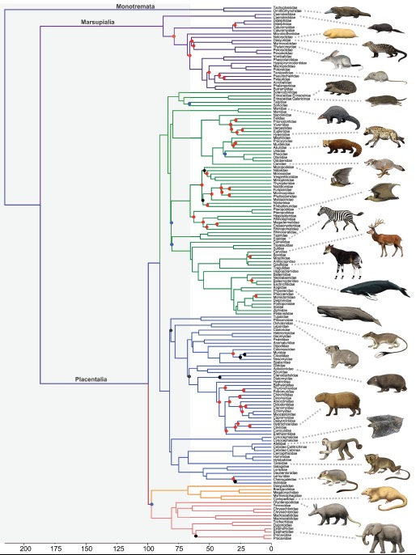
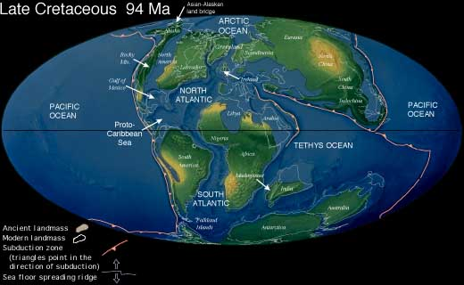
Scale: Mammalian Evolution
Ancester of Eutherian (placental)
Mammals arose ~100 MYA
KTR (Cretaceous Terrestrial Revolution)
80-82 MYA
KPg (Cretaceous Paleogene mass extinction)
65.5 MYA
/ www.sciencexpress.org / 22 September 2011 / Page 1/ 10.1126/science.1211028

Slide 13
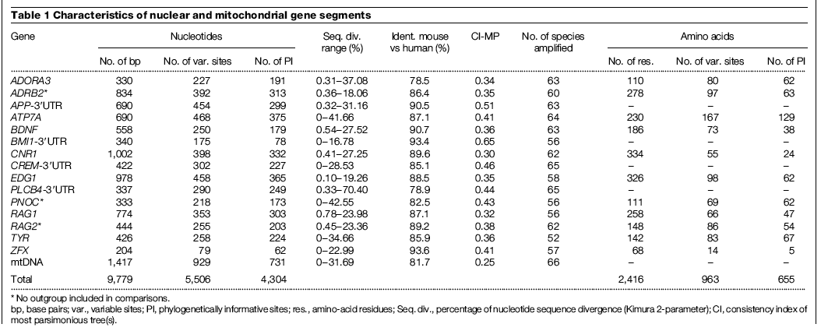
Experimental Design: Mammalian Evolution
/ www.sciencexpress.org / 22 September 2011 / Page 1/ 10.1126/science.1211028

Slide 14
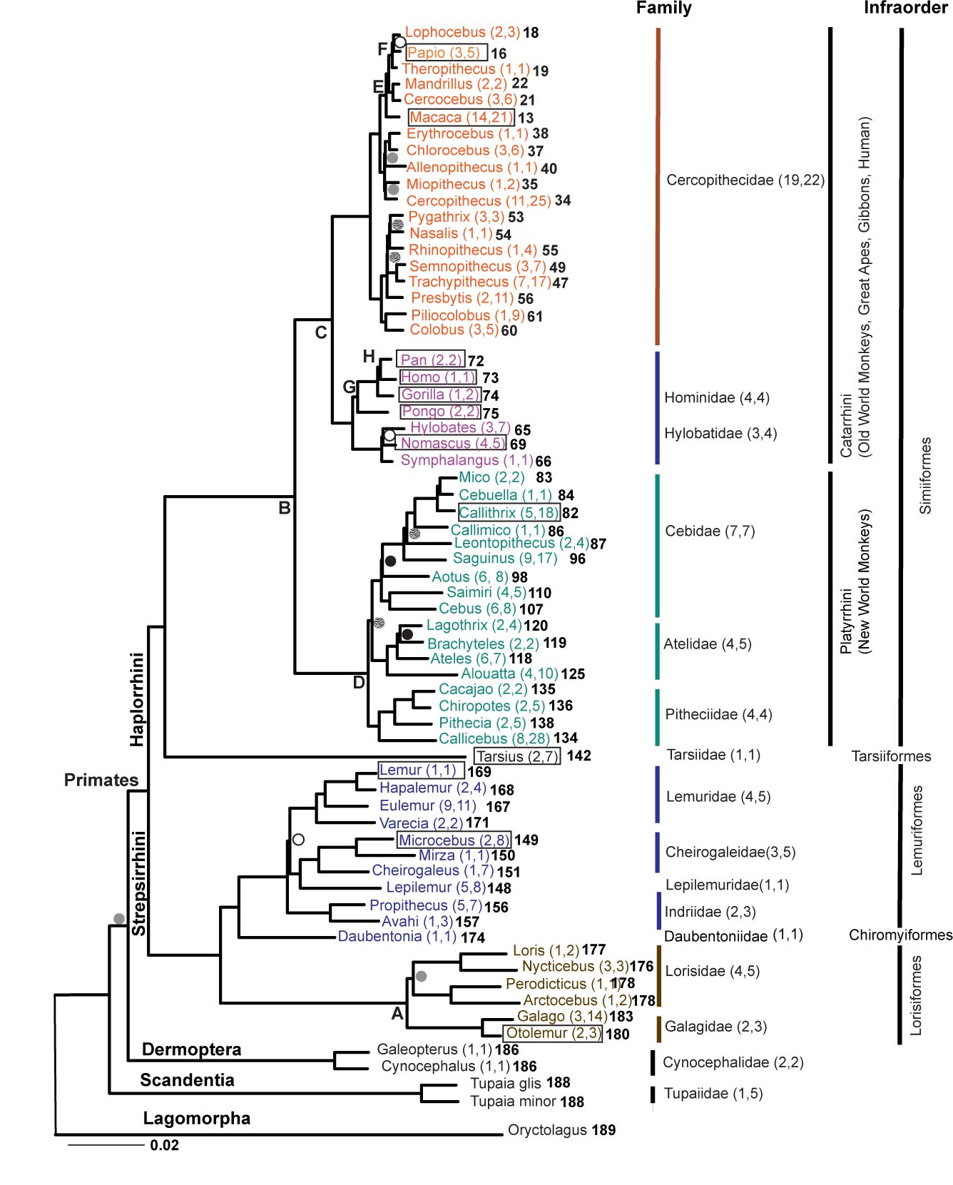
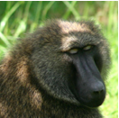
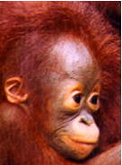
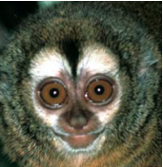
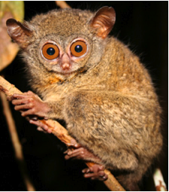
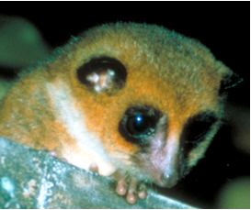
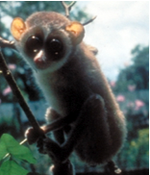
Scale : Primate Evolution
SAMPLING
Representing 90% of diversity present in Primate Order
~90% genera, ~50% species
Boxed species are those either completed or in progress for Whole Genome Sequence
60 Primate Genera, 5 outgroups,
Informative geness of primate evolution
54 genes
Exon, intron, UTR regions
X, Y and Autosomal locations
Large-Scale Sequencing
43,943 sites edited to 34,927 sites
8.4 Mb data reduced to 6.7 Mb of aligned sequence data
PHYLOGENETIC RECONSTRUCTION
Maximum Likelihood (Garli ver 0.96)
Maximum Parsimony (PAUP ver 4d106dev_icc)
DATING NODES (BEAST)
Calibrated by fossil record
A Galigidae-Lorisidae split 38-42 MYA
B Simiiformes 36-50 MYA
C Catarrhini 20-38 MYA
D Platyrrhini 20-27 MYA
E Papionini 6-8 MYA
F Theropithecus 3.5-4.5 MYA
G Hominidae 13-18 MYA
H Homo-Pan split 6-7 MYA

Slide 15
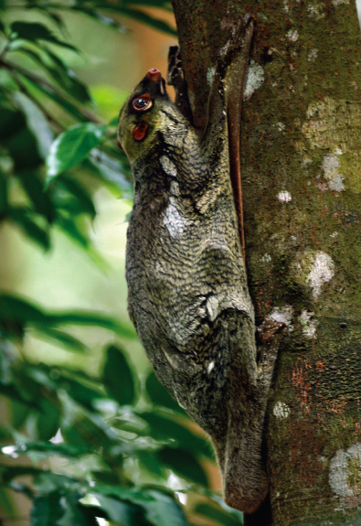
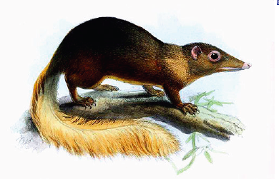
Molecular Phylogeny of 186 primates, 5 outgroup taxa, rooted by Lagomorpha
Highly Resolved
Bootstrap values 90-100% at 166/189 nodes
Only 3 of 189 nodes (28, 38, 158) polytomy
Systematic Hierarchy
2 Suborders
5 Infraorders
2 Parvorders
2 Superfamilies
14 Families
14 Subfamilies?
4 Tribes?
Resolution of Early Primate Divergence
Origin of living primates 87 MYA
Closest Mammalian Order:
Dermoptera (flying lemurs)
Scandentia (tree shrews)
87 MYA
Perelman P, Johnson WE, Roos C, Seuánez HN, Horvath JE, et al. (2011) A Molecular Phylogeny of Living Primates. PLOS Genetics 7(3): e1001342. https://doi.org/10.1371/journal.pgen.1001342
http://journals.plos.org/plosgenetics/article?id=10.1371/journal.pgen.1001342

Slide 16
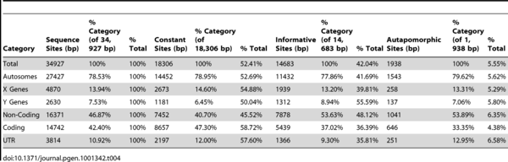

Partitions of Informative Markers
Table 4. Sequence Variation by Gene Category and Data Partition in Primate Phylogeny after Correction For Ambiguous Sites.
Perelman P, Johnson WE, Roos C, Seuánez HN, Horvath JE, et al. (2011) A Molecular Phylogeny of Living Primates. PLOS Genetics 7(3): e1001342. https://doi.org/10.1371/journal.pgen.1001342
http://journals.plos.org/plosgenetics/article?id=10.1371/journal.pgen.1001342

Slide 17
Scale: Species and Subspecies Great Apes
Kuhlwilm, M. et al Evolution and demography of the great apes. Current Opinion in Genetics & Development 2016, 41:124–129

Slide 18
Whole Genome Informative Markers: Great Apes Species and Subspecies
J Prado-Martinez et al. Nature 000, 1-5 (2013) doi:10.1038/nature12228

Slide 19
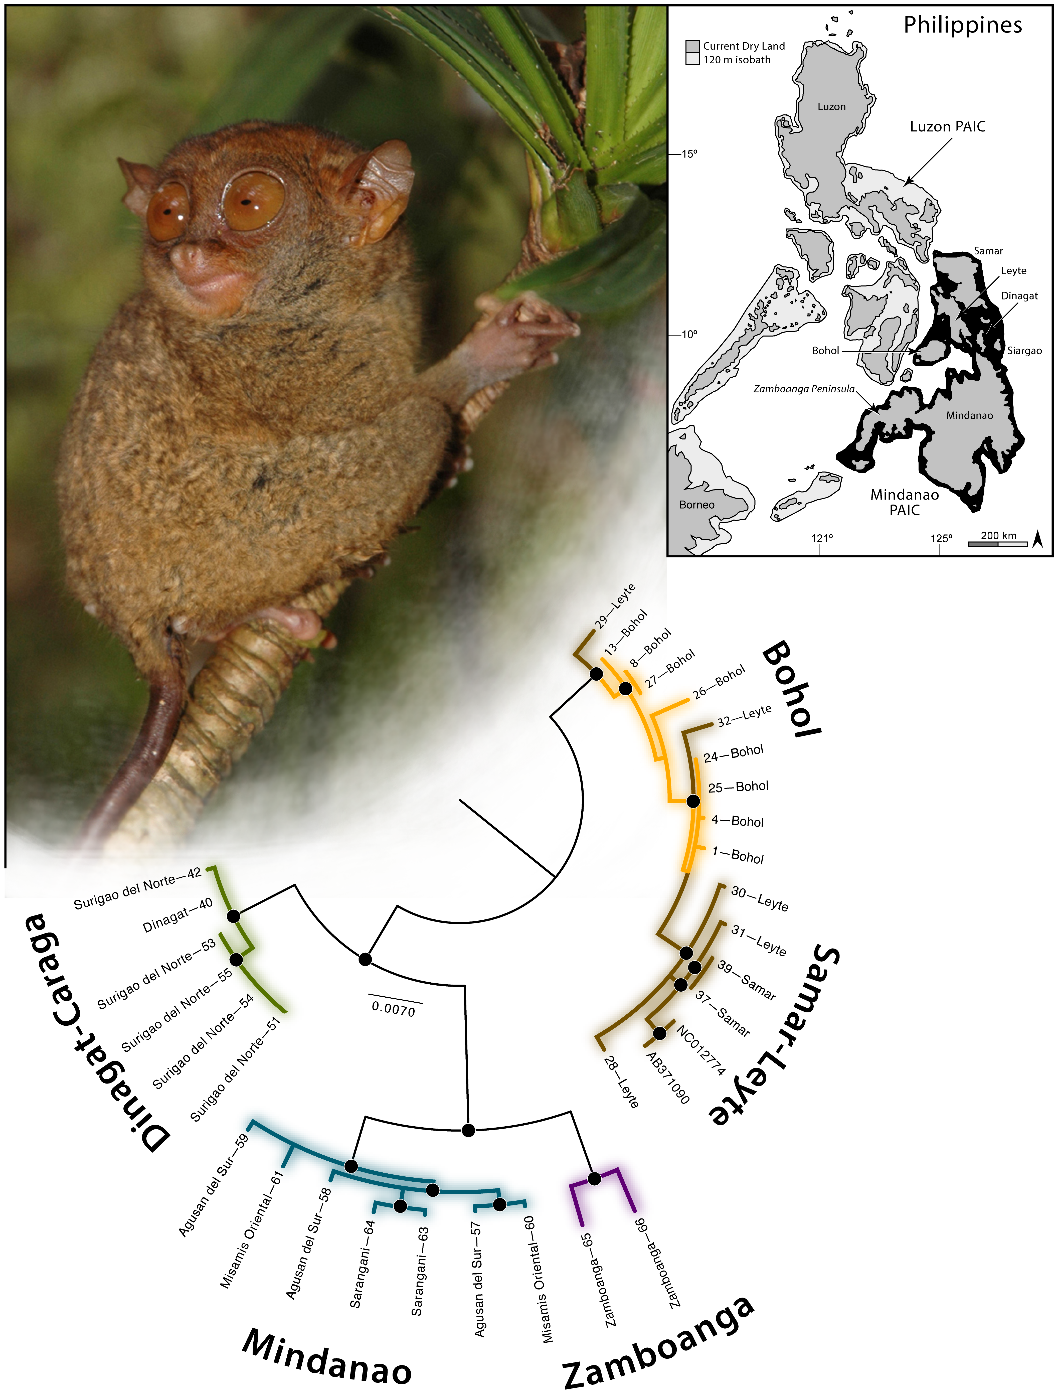
Scale: Species Phylogeography
Criteria:
Representative voucher specimens from all putative subspecies
And/Or
Representatives from throughout species range
Figure 1. Phylogeographic relationships of Tarsius syrichta estimated from a combined, partitioned, RAxML ML analysis of mitochondrial (12S, CytB, ND2) gene fragments.
Brown RM, Weghorst JA, Olson KV, Duya MRM, Barley AJ, et al. (2014) Conservation Genetics of the Philippine Tarsier: Cryptic Genetic Variation Restructures Conservation Priorities for an Island Archipelago Primate. PLOS ONE 9(8): e104340. https://doi.org/10.1371/journal.pone.0104340
http://journals.plos.org/plosone/article?id=10.1371/journal.pone.0104340

Slide 20
Scale: Pathogen Taxonomy Morbilliviruses within Paramyxoviridae
Nambuli et al. Mapping the evolutionary trajectories of morbilliviruses: what where wither. Current Opinion in Virology 2016, 16:95–105

Slide 21
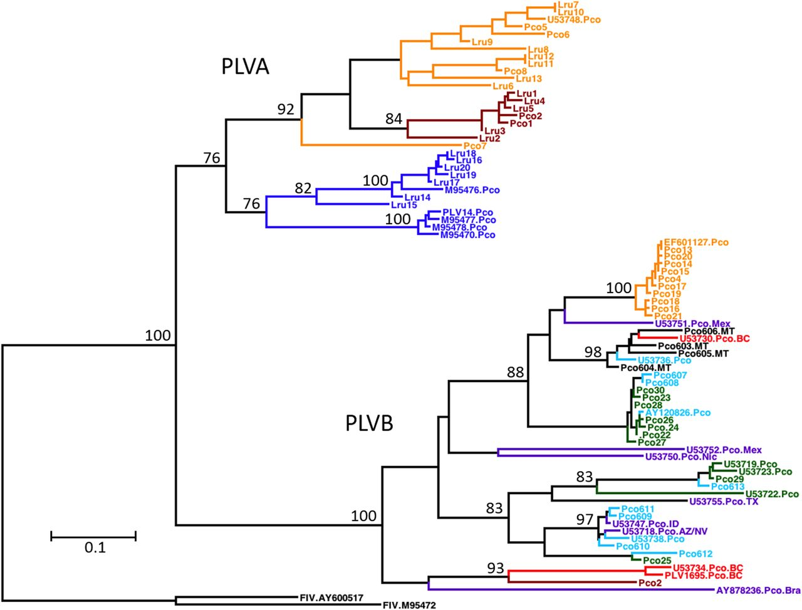
PLVA and PLVB exhibit distinct evolutionary histories and different contemporary phylogeographic distributions.
Justin S. Lee et al. J. Virol. 2014;88:7727-7737
Notes:
PLVA and PLVB exhibit distinct evolutionary histories and different contemporary phylogeographic distributions. This is a maximum likelihood phylogenetic tree constructed from a 471-bp region of pol illustrating the relationship among the isolates analyzed in this study and previously reported PLV sequences (n = 80 isolates; 48 PLVB and 32 PLVA isolates). Bootstrap values (100 replicates) with >70% support are indicated on nodes. Branch lengths represent the numbers of substitutions per site (see the scale bar). Two domestic cat FIV sequences (chosen to provide continuity with data reported previously by Franklin et al. [8]) were included as an outgroup. Isolate names and colors are the same as those described in the legend of Fig. 2 (see also Fig. SA2 in the supplemental material). Sequences from geographic regions outside our study areas are depicted in purple and are labeled with the GenBank accession number and sample location (BC, British Columbia; AZ/NV, Arizona/Nevada; ID, Idaho; Mex, Mexico; Nic, Nicaragua; Bra, Brazil; TX, Texas).

Slide 22
Scale: Strain Host Specificity and Origins
Newly Emergent (Identified) Strains
FeMV
CeMV
Phocine Distemper
Whole genome sequences

Slide 23
Scale: Strain Host Specificity and Origins
Feline Morbillivirus Recent Diversification

Slide 24
Scale: Pathogen evolution within host individuals
Multiply-infected individuals have increased frequency of recombinant formation
Quasi-speciation
Lentiviruses
Clonal diversification
Primate T-Cell Leukemia Viruses (long latency)
Host-like genomic rates of change

Slide 25
Quasi-speciation in Host-specific FIV In Natural Population of

Slide 26
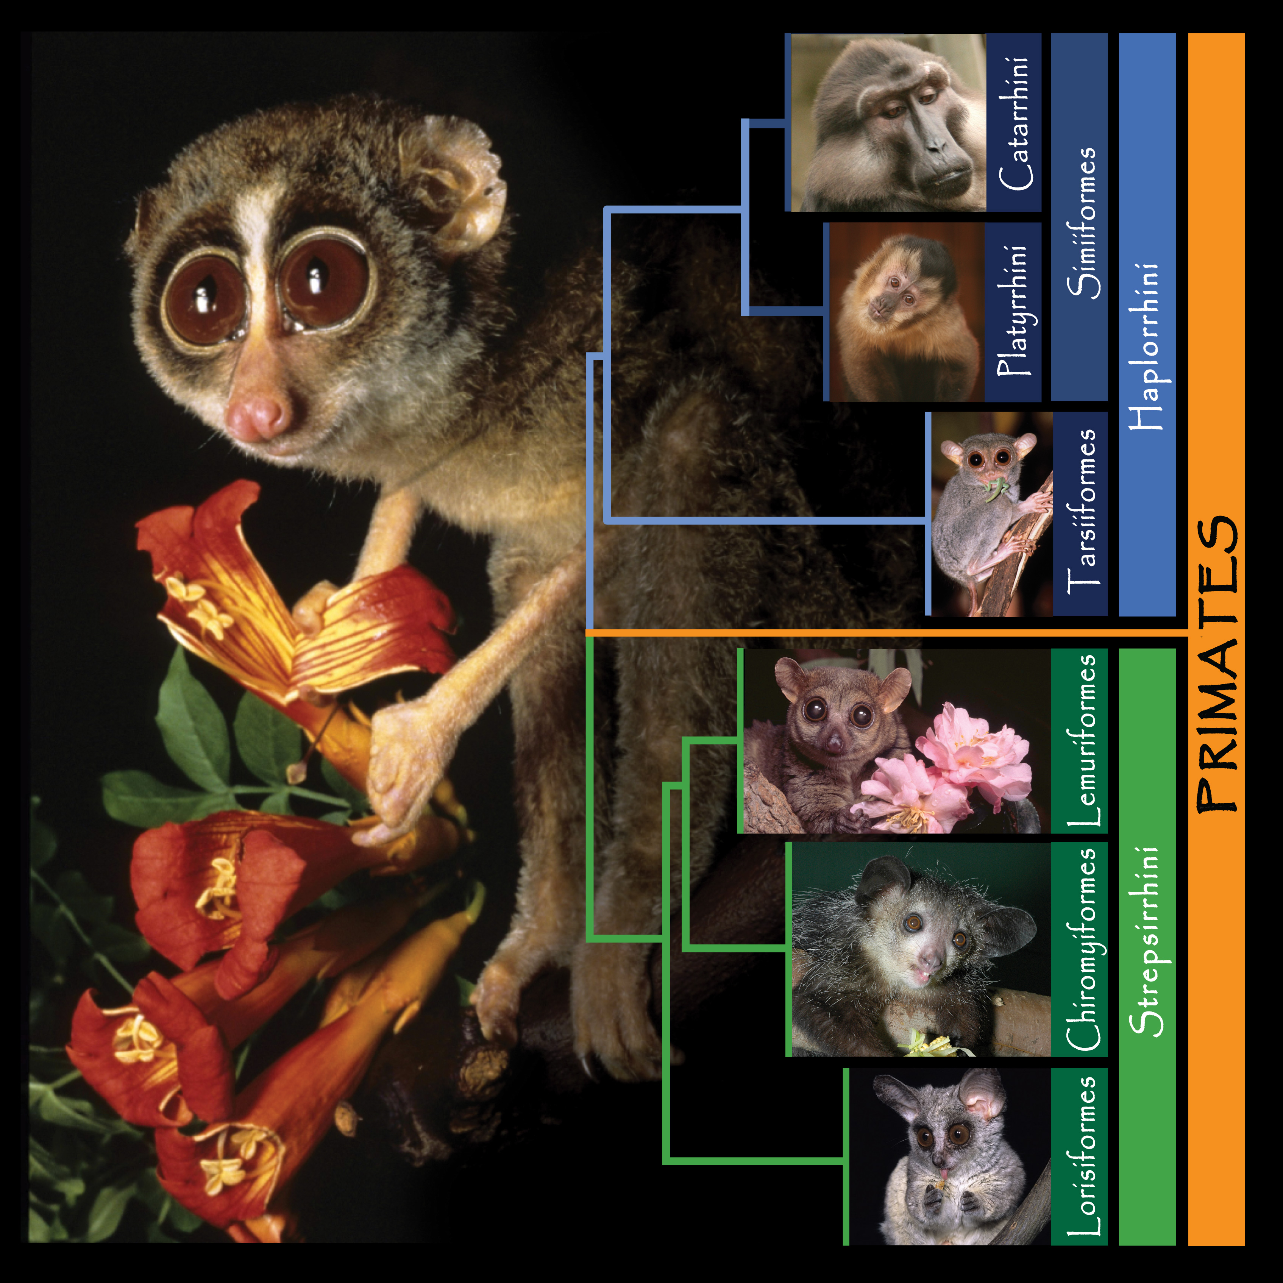


Slide 27
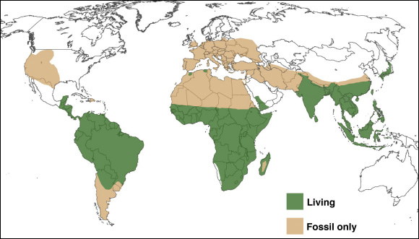
Global Distribution of Primate Species

Slide 28
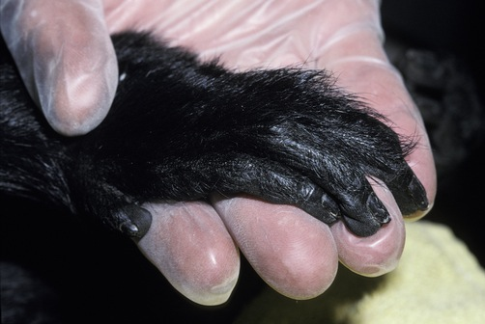
Laying the Foundation: The Complex Order of Primates
Initially imputed from morphological, adaptive, bio-geographical, reproductive and behavioral traits
Species counts range from 261-377, ~ 630 species, subspecies
Genera count range from 67-69 or more?
Genetic studies have been informative but limited:
Too few taxa
Too few gene regions
Super-matrix of all published sequences large proportion of missing data (59-85%) per taxon

Slide 29
Methods
SAMPLING
Representing 90% of diversity present in Primate Order
~90% genera, ~50% species
Boxed species are those either completed or in progress for Whole Genome Sequence
60 Primate Genera, 5 outgroups,
Informative genes of primate evolution
54 genes
Exon, intron, UTR regions
X, Y and Autosome locations
Large-Scale Sequencing
43,943 sites edited to 34,927 sites
8.4 Mb data reduced to 6.7 Mb of aligned sequence data
PHYLOGENETIC RECONSTRUCTION
Maximum Likelihood (Garli ver 0.96)
Maximum Parsimony (PAUP ver 4d106dev_icc)
DATING NODES (BEAST)
Calibrated by fossil record
A Galigidae-Lorisidae split 38-42 MYA
B Simiiformes 36-50 MYA
C Catarrhini 20-38 MYA
D Platyrrhini 20-27 MYA
E Papionini 6-8 MYA
F Theropithecus 3.5-4.5 MYA
G Hominidae 13-18 MYA
H Homo-Pan split 6-7 MYA

Slide 30
Molecular Phylogeny of 186 primates, 5 outgroup taxa, rooted by Lagomorpha
Highly Resolved
Bootstrap values 90-100% at 166/189 nodes
Only 3 of 189 nodes (28, 38, 158) polytomy
Systematic Hierarchy
2 Suborders
5 Infraorders
2 Parvorders
2 Superfamilies
14 Families
14 Subfamilies?
4 Tribes?
Resolution of Early Primate Divergence
Origin of living primates 87 MYA
Closest Mammalian Order:
Dermoptera (flying lemurs)
Scandentia (tree shrews)
87 MYA

Slide 31
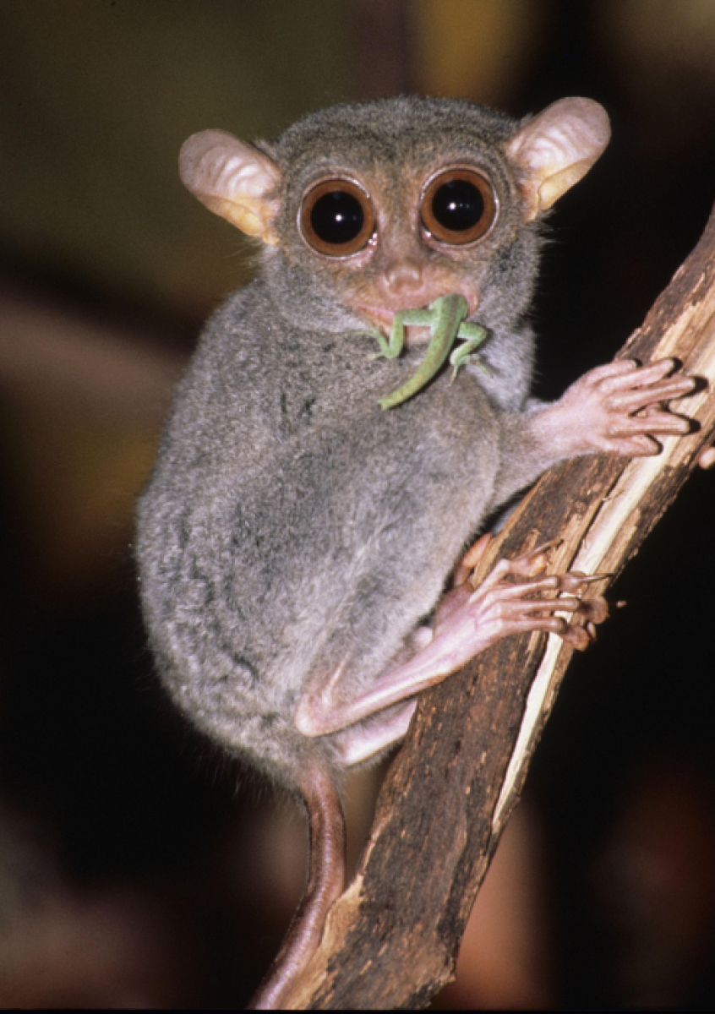
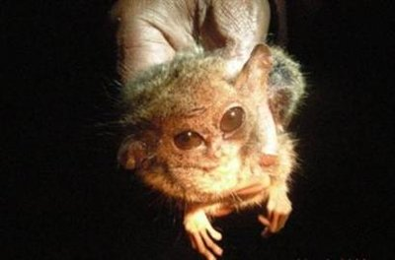
Resolution of Deep Nodes: Ancient Origins and Relic Lineages
Ancient Origin of the Tarsier
Tarsiiformes + Simiiformes = Haplorrhini
Smallest primate –pygmy tarsier
81 MYA
58 MYA
68 MYA
40 MYA

Slide 32
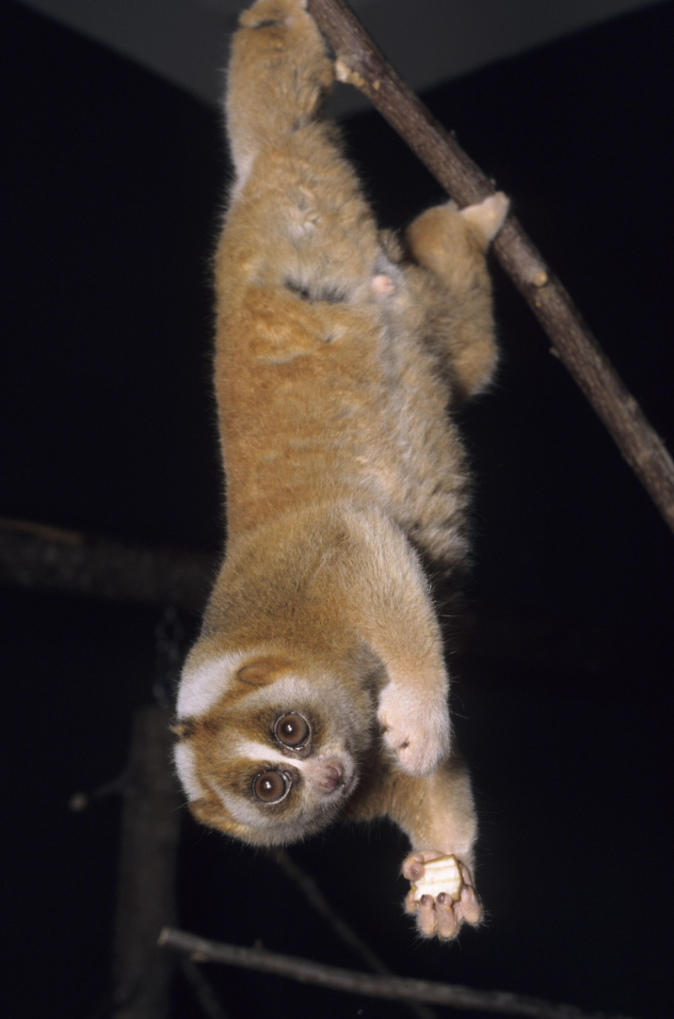
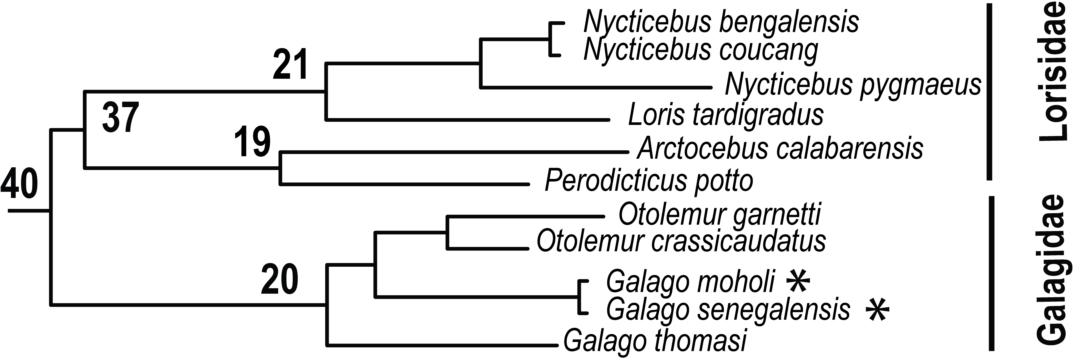
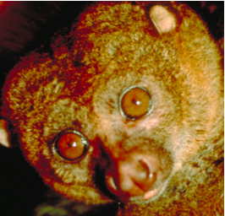
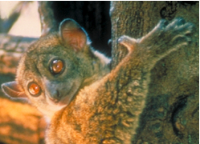
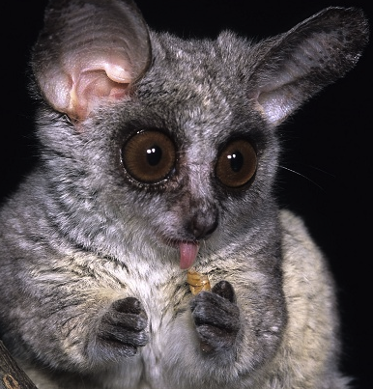
Strepsirrhini: Lorisiformes
Potto, Loris, Bushbaby
Lorisidae
Most divergent of all primates families
(4-5 times that of Hominidae)
Low numbers of species (1-3 per genus)
Galagidae
Ancient ancestry and recent speciation
in Galago genus (~14 species)

Slide 33
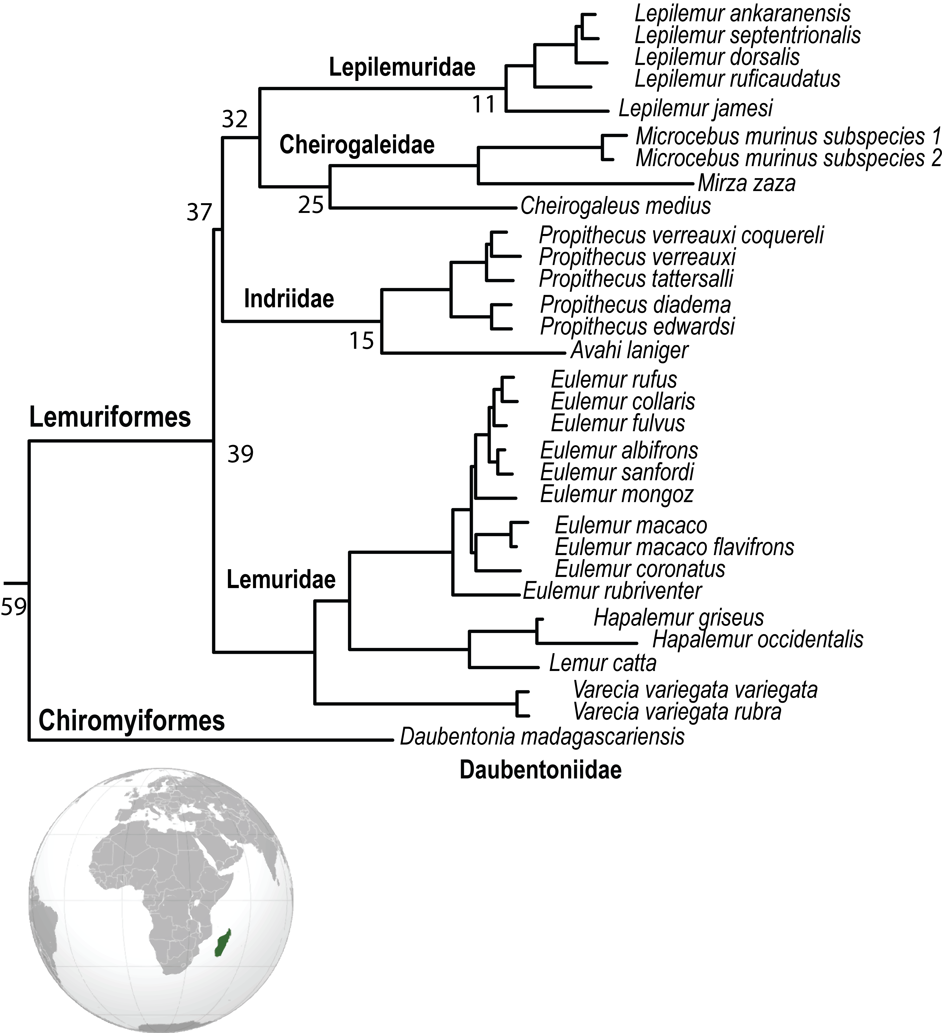
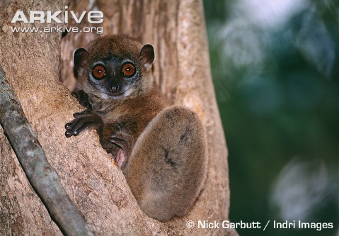
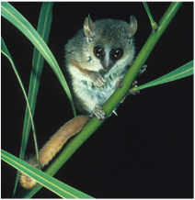
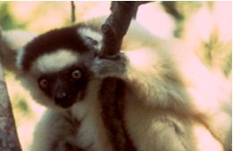
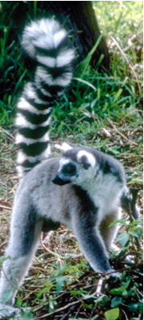
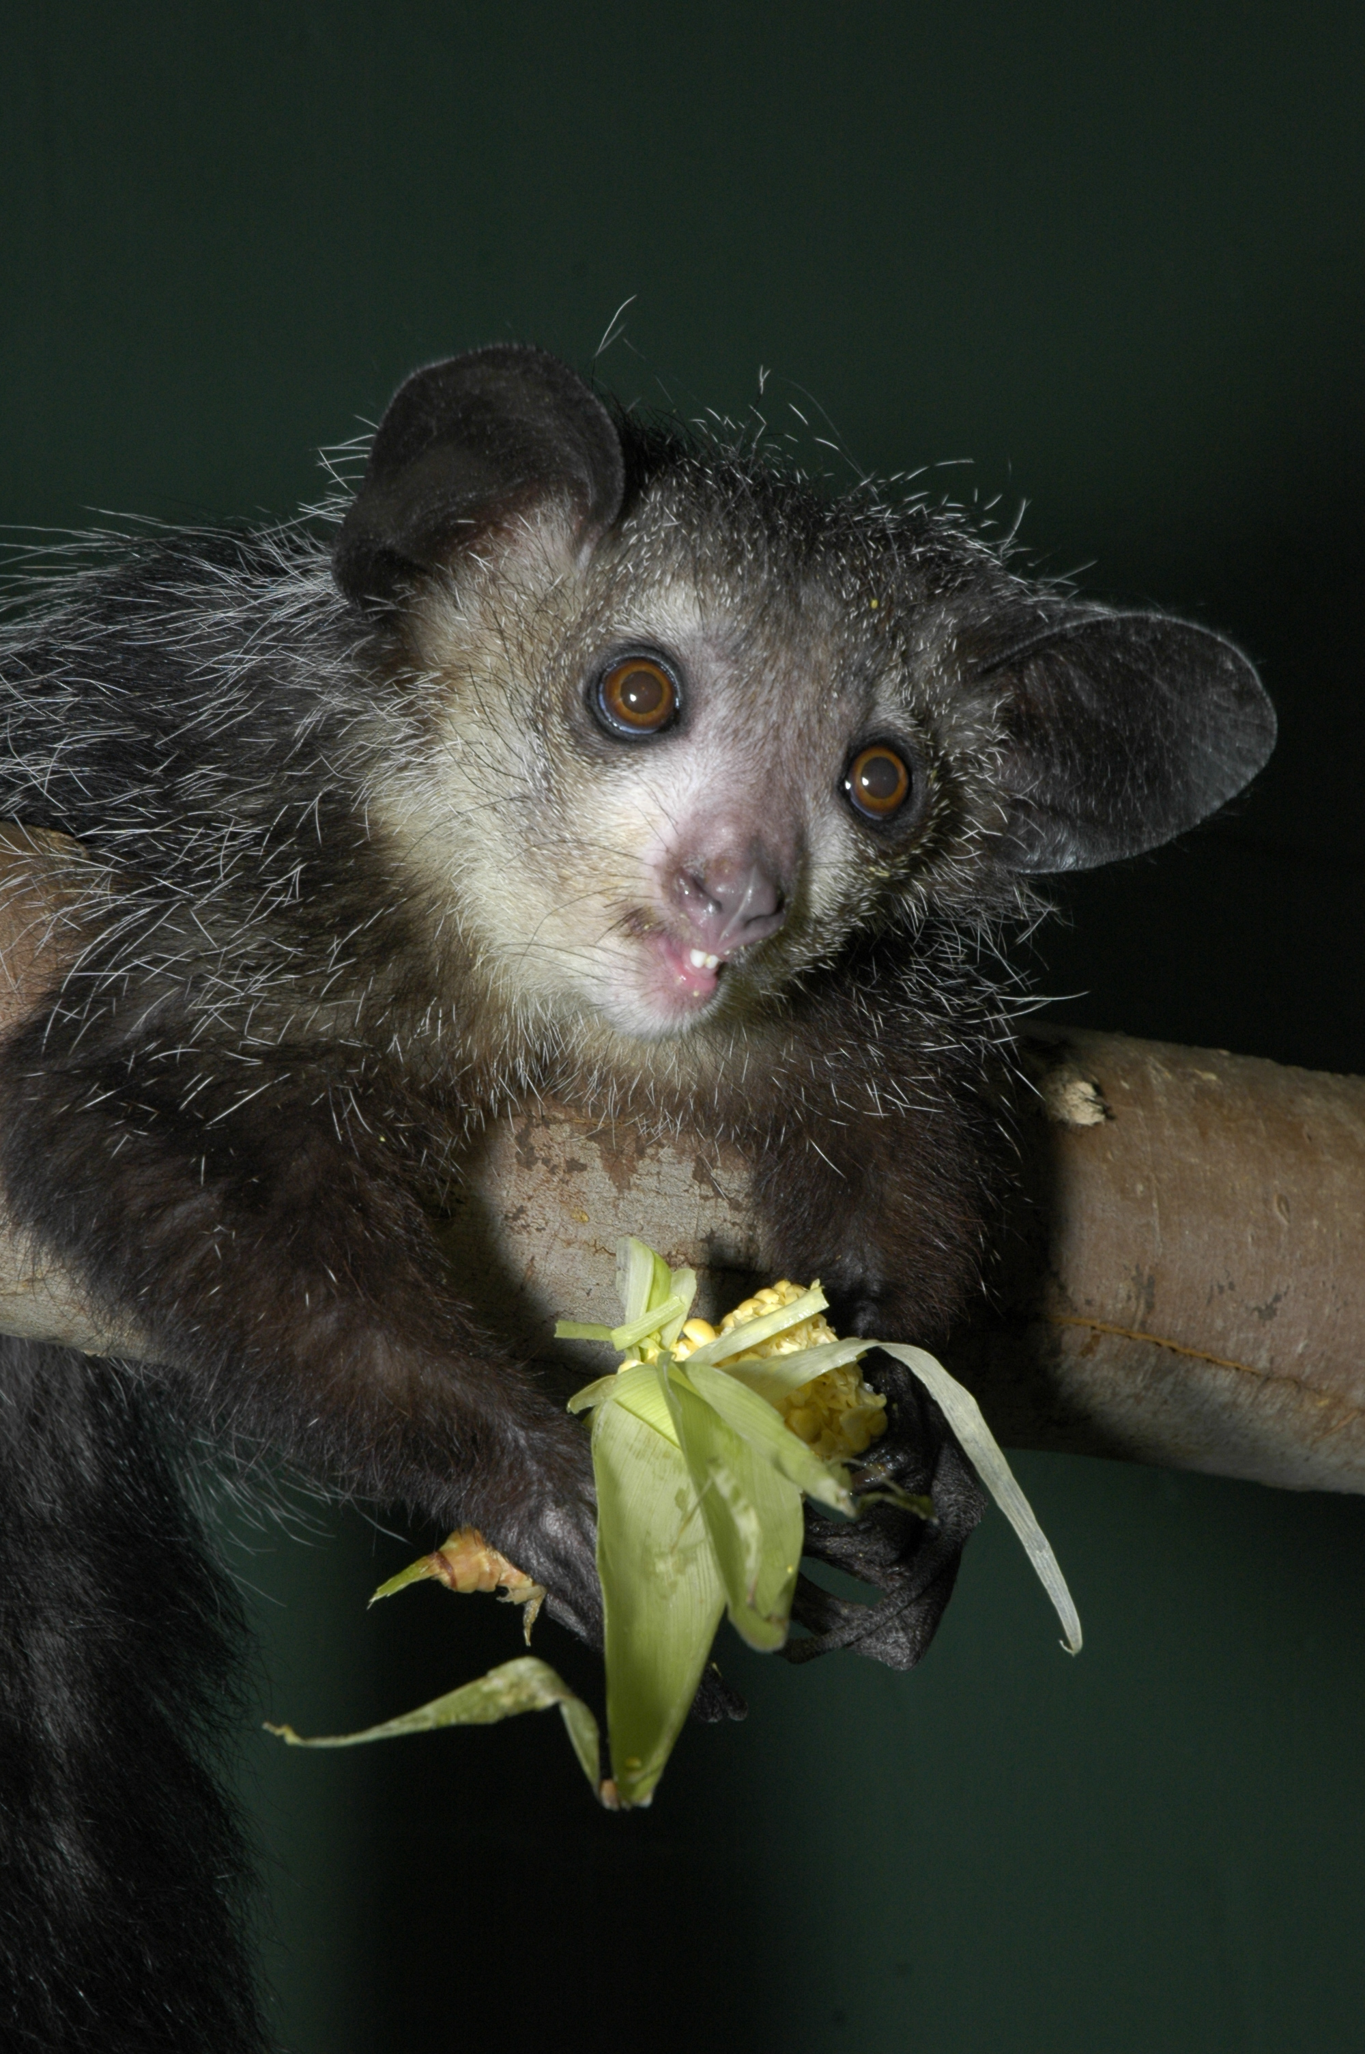
Strepsirrhini: Malagazy Lemurs
Malagazy Lemurs
Two Ancient Infraorders
Common ancestor colonized Madagascar
Extensive diversification
~97 species of lemur
Numerous adaptations
Notes:
Common ancestors of Chiromyiformes and Lemuriformes likely colonized the island of Madagascar prior to 58.6 MYA (node 174).
Noted for extensive adaptive evolution, the relative hierarchical branching patterns of the four Lemuriformes families (Indriidae, Lepilemuridae, Lemuridae, Cheirogaleidae) recognized by taxonomists, has proven difficult to resolve conclusively.
Inferences on species versus subspecies classification are controversial with as many as 97 Malagasy lemurs [22] under taxonomic review.
Chiromyiformes diverged from a common ancestor with Lemuriformes shortly after colonisation of Madagascar [14,19] and today consists of a single relict genus Daubentonia defined by a long branch with high indel frequency (N=14) (Figure 2, Figure S1, Table S7).
The evolution of the four Lemuriformes families began 38.6 MYA (node 173) with the emergence of Lemuridae, followed by Indriidae and a monophyletic lineage that split 32.9 MYA (node 152) to form the sister lineages of Lepilemuridae and Cheirogaleidae.
This branching pattern among families agrees with earlier nuclear gene segment findings [20] that differ from studies using mtDNA sequence and Alu insertion variation which were unable to resolve these hierarchical associations [19]. Further, relatively weak nodal support here collapses Lemuriformes into an unresolved trichotomy of Lemuridae, Indriidae, and the Lepilemuridae + Cheirogaleidae lineage (node 158). Optimal resolution of this node is observed with exon sequences (Figures S8 & S9), indicating that intron sites may be saturated, while more conserved coding regions remain informative and reflect the ancient rapid radiation of Lemuriformes families.

Slide 34
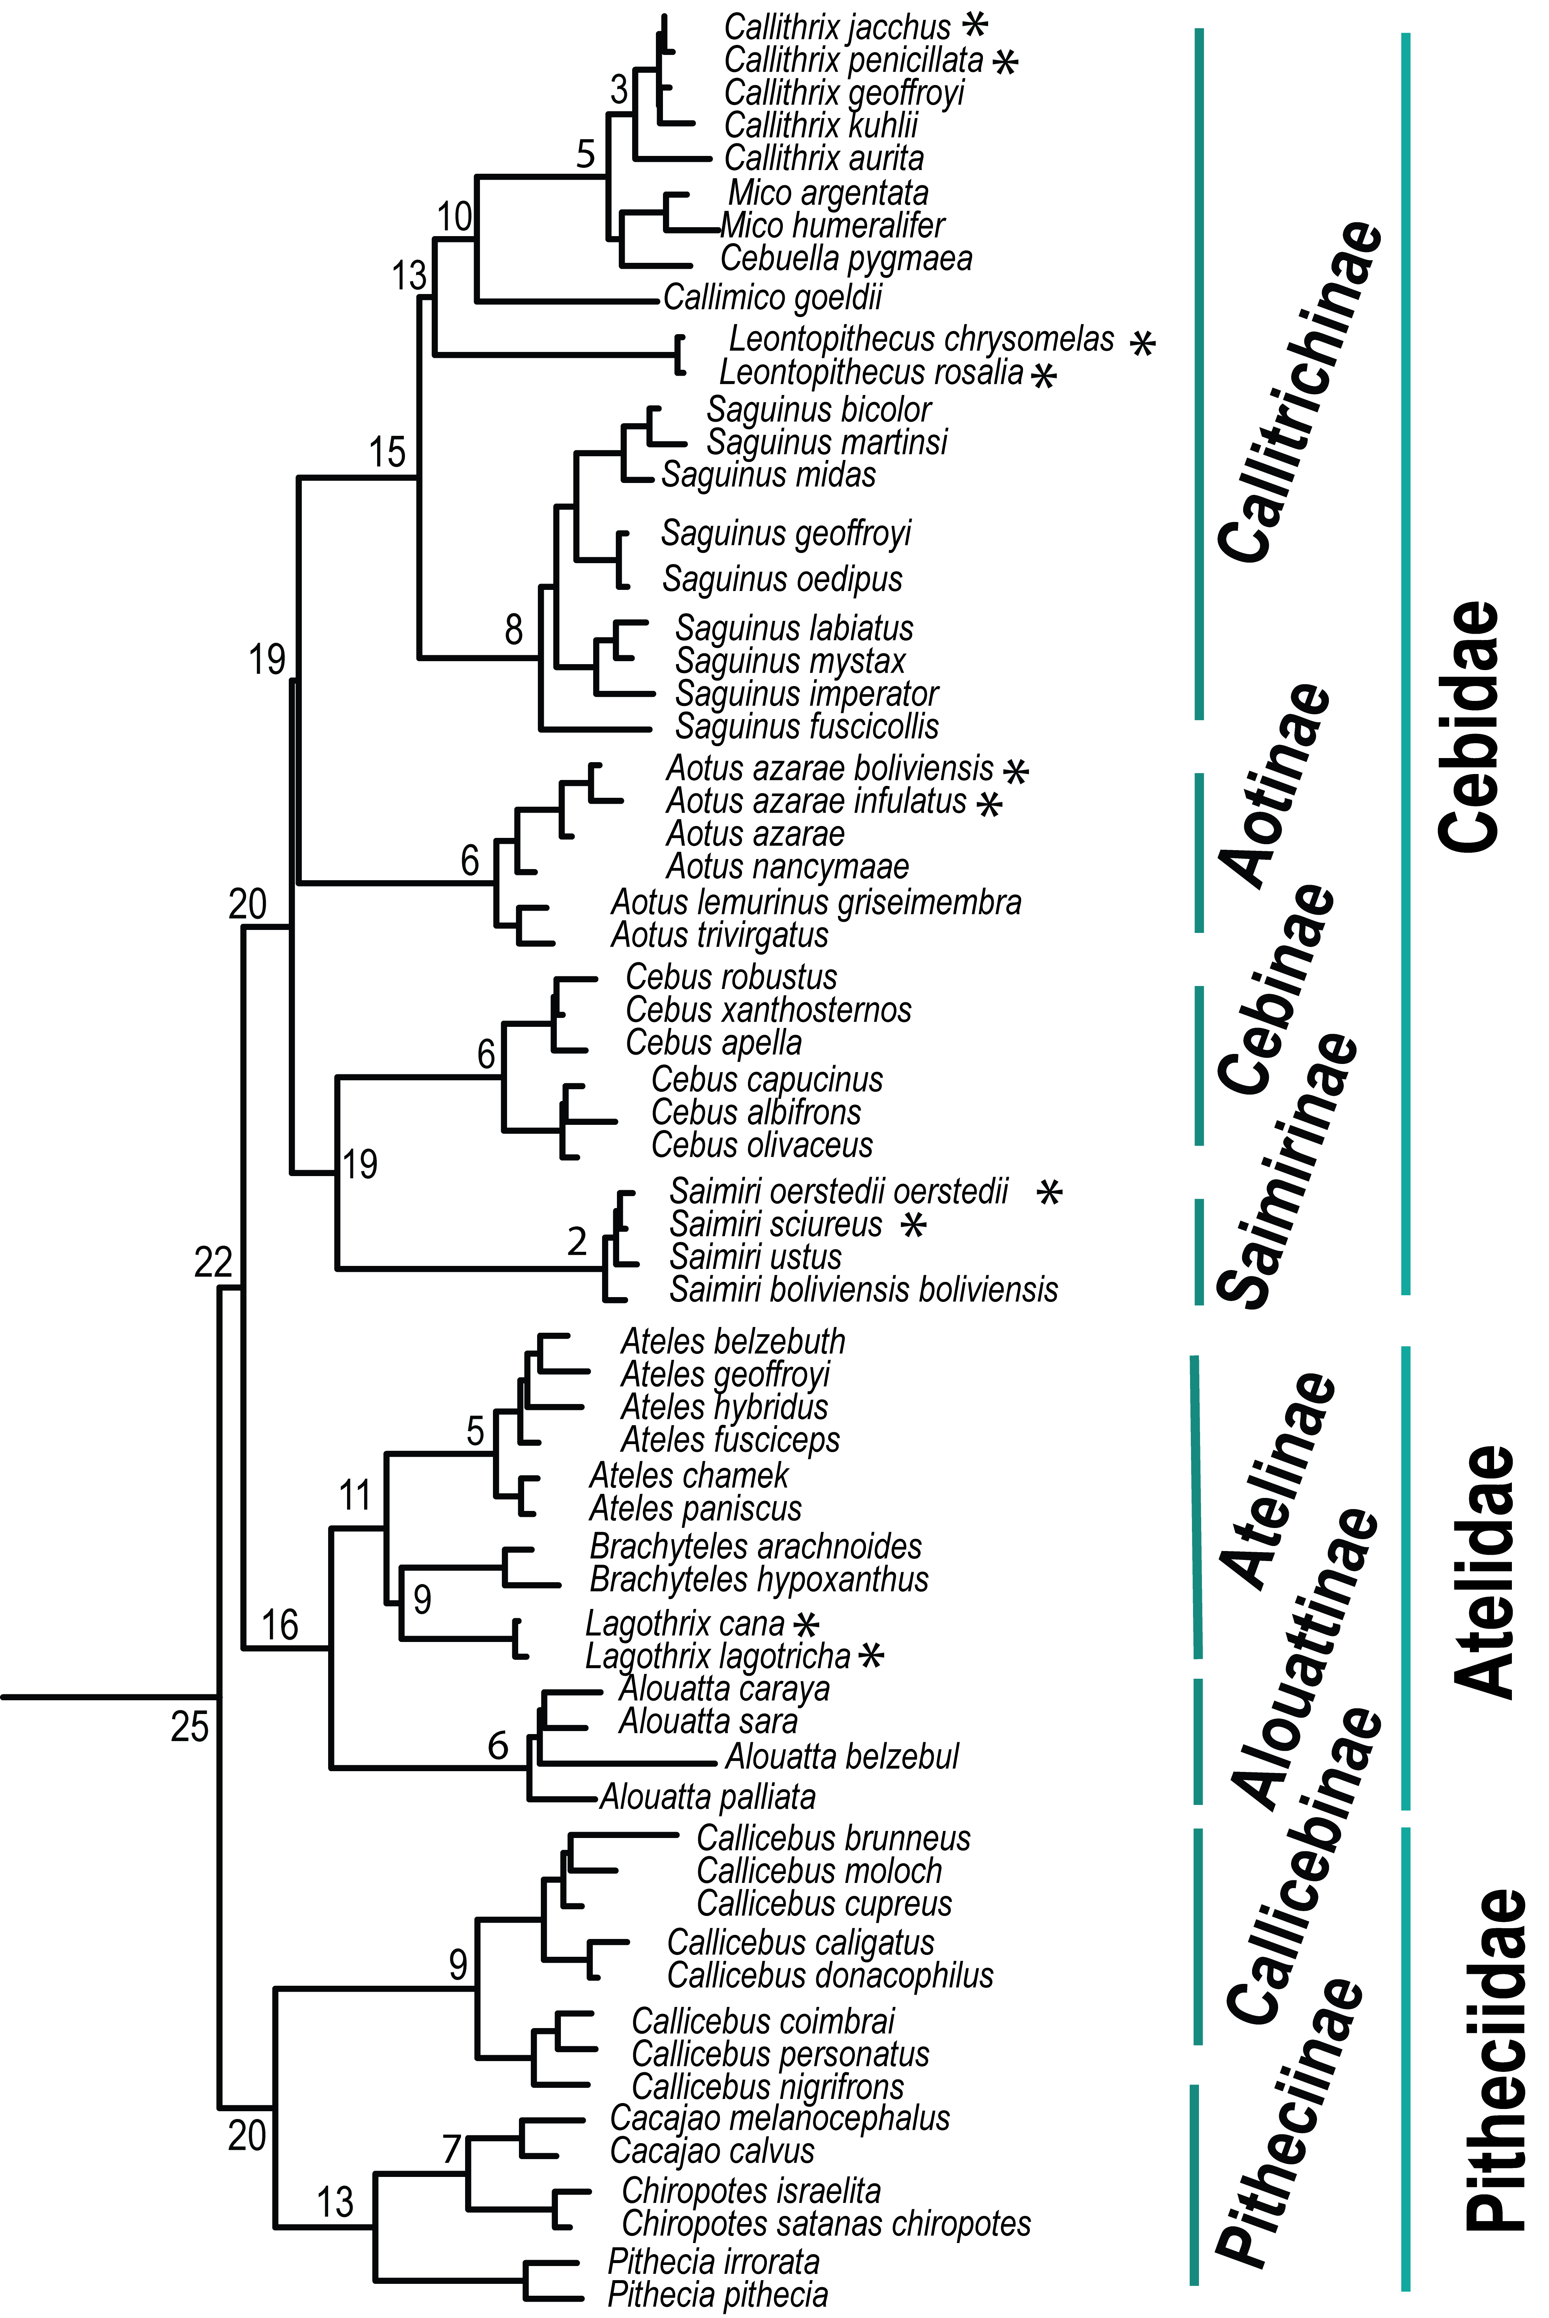
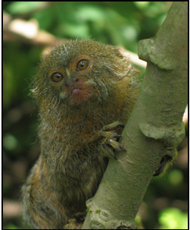
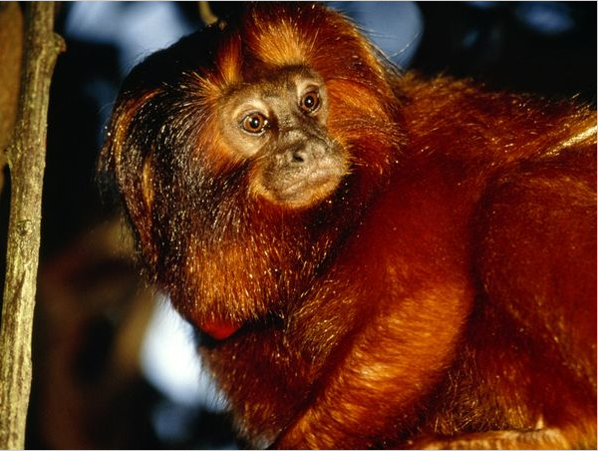
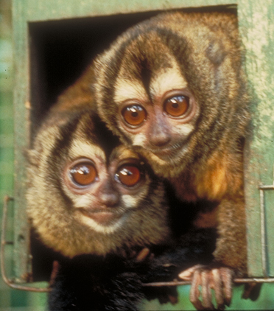
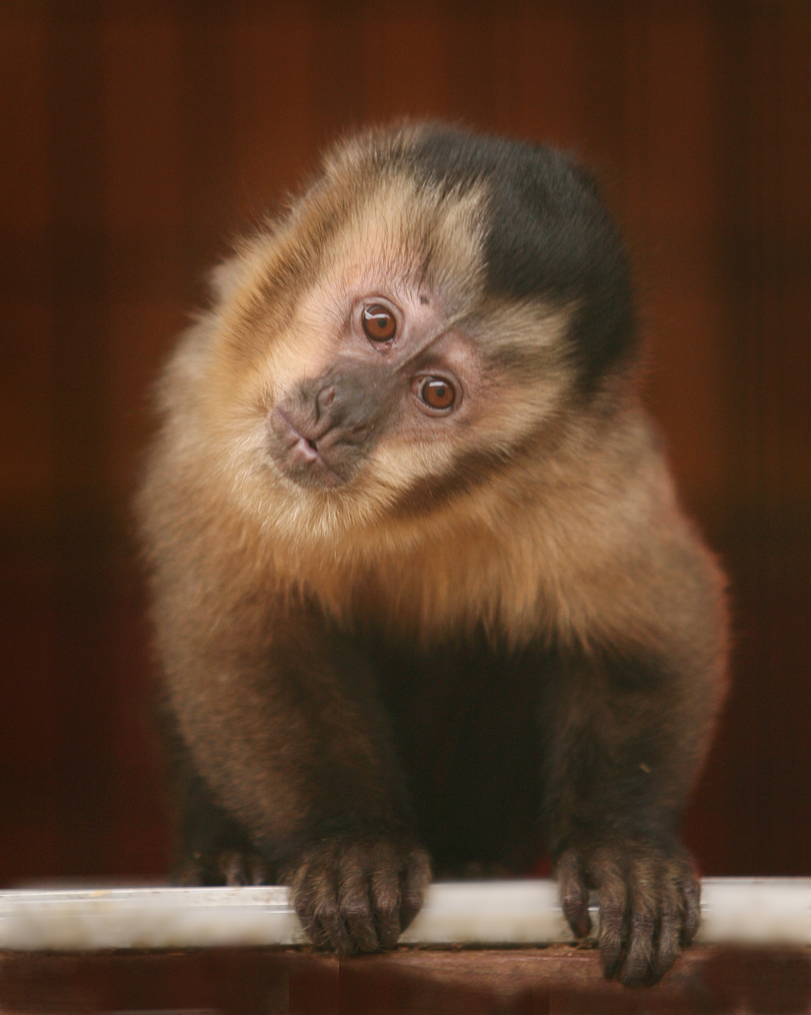
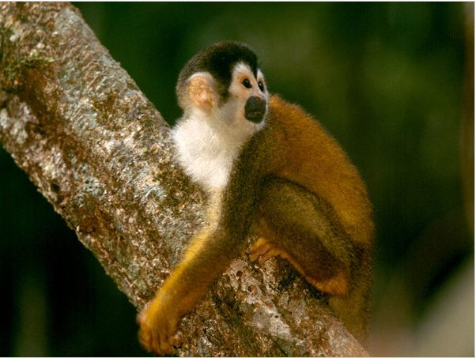
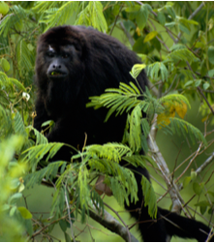
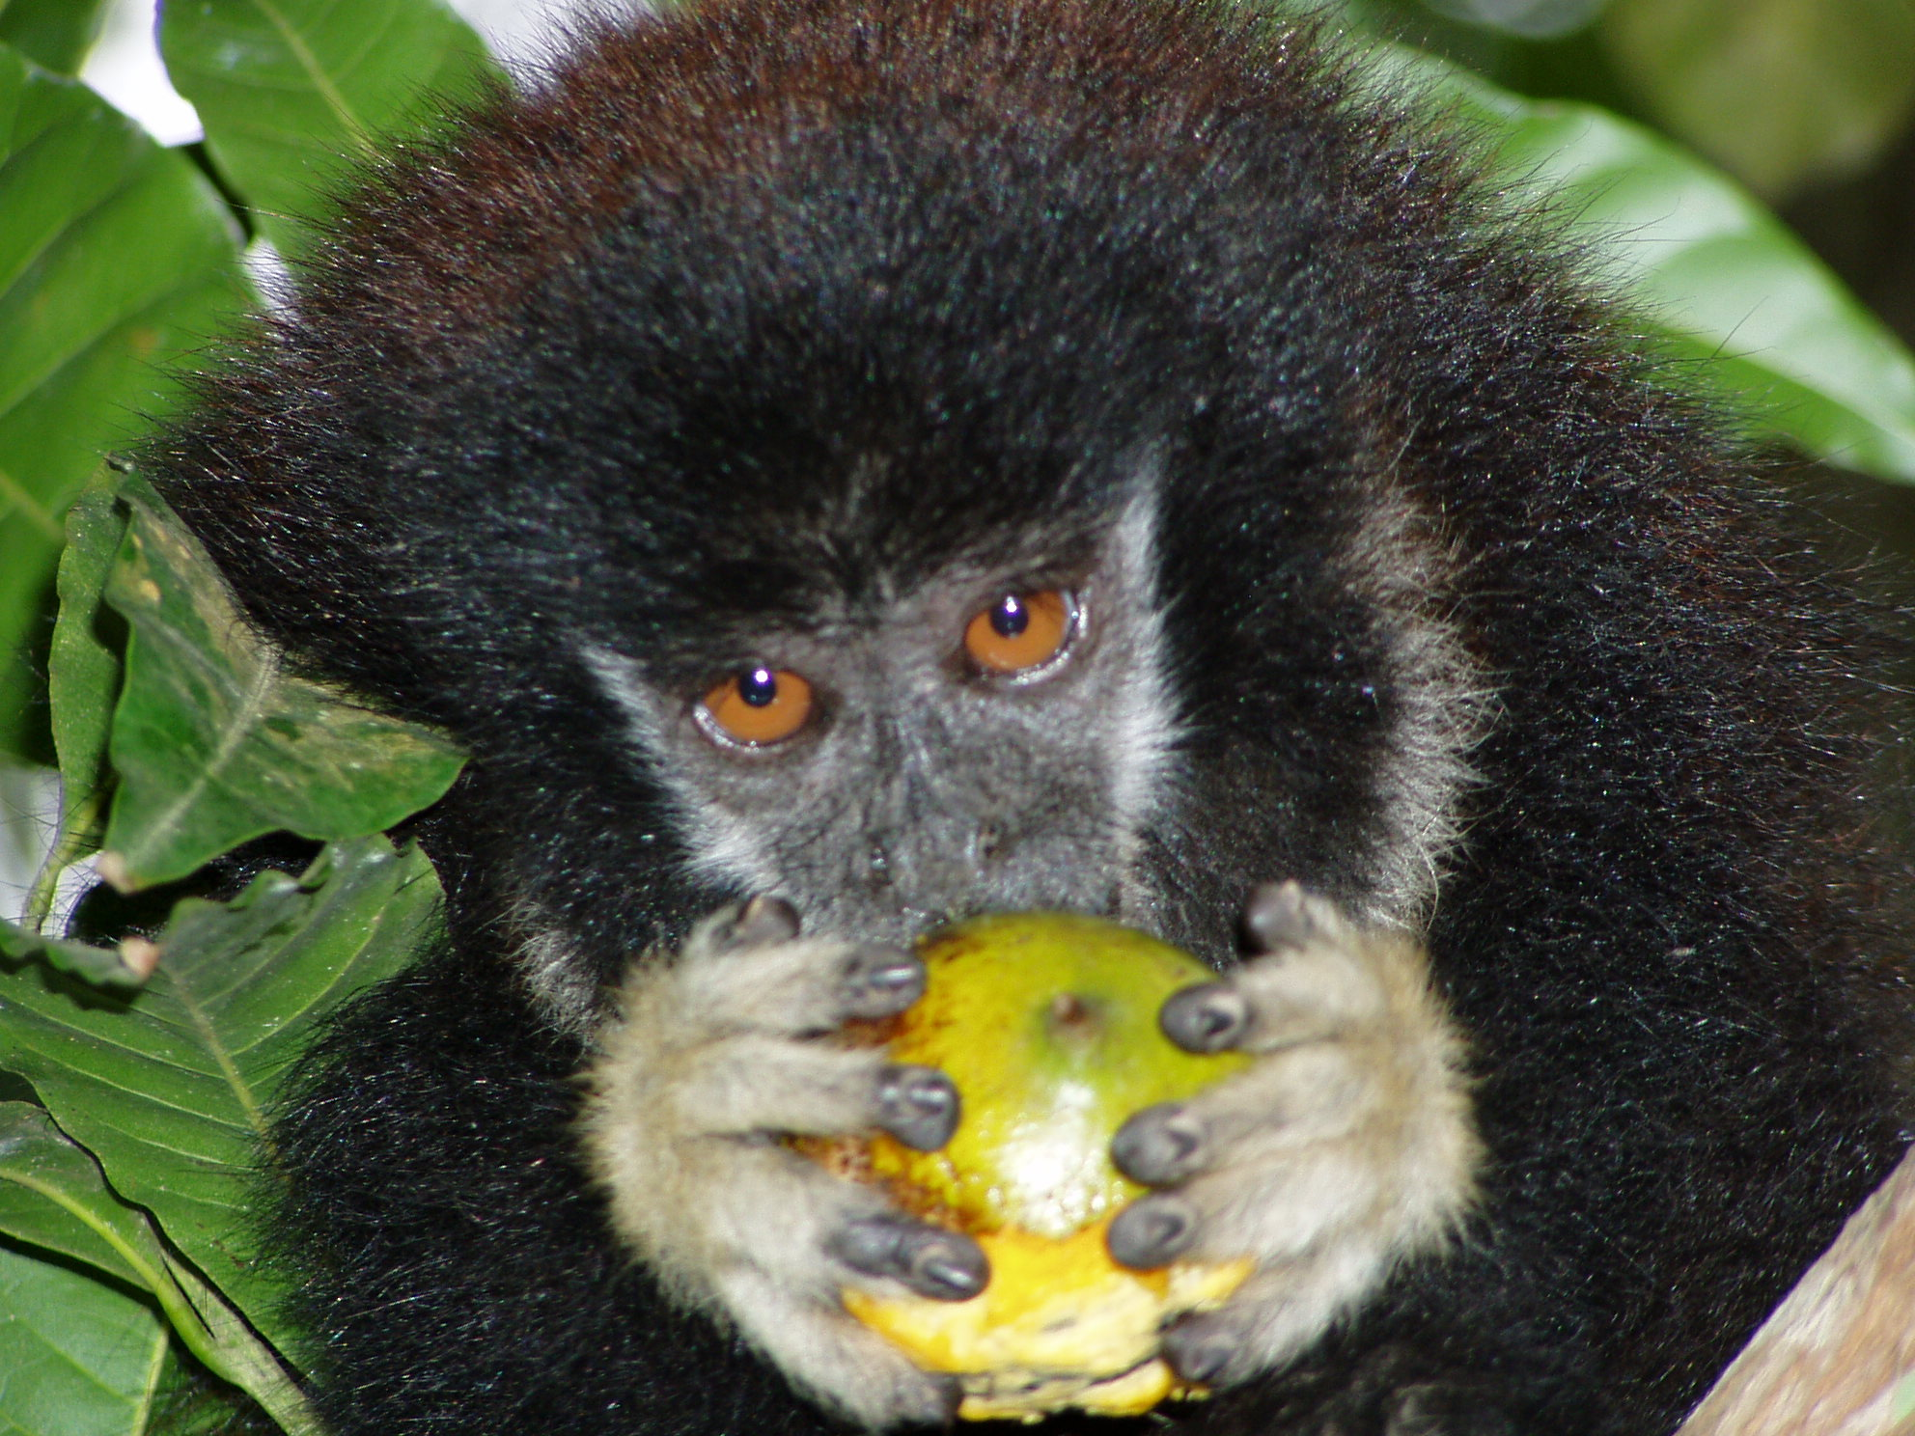
Platyrrhini (New World Primates)
Resolution of Branching Order of Families
25 MYA
Placement of Aotinae (nocturnal species)
Phyletic dwarfism within Cebidae
Adaptive “speed up” at specific branches
Notes:
Nodes 99 100
The phylogeny clarifies formerly unresolved questions concerning New World primate evolution including branching order among families, relative divergence of genera within families, and phylogenetic placement of Aotus, and provides genetic support for examples of adaptive evolution that led to nocturnalism, “phyletic dwarfism” and species diversification within the Amazonian rainforest. Here, Platyrrhini clearly diverged from a common ancestor with Catarrhini (node 141) roughly 43.5 MYA during the Eocene. Although questions remain about the route and nature of primate colonization of the New World [23,24] and the impact of historic global climate change in neotropical regions [25,26], the phylogeny unambiguously resolves the relative divergence pattern among families from a common ancestor 24.8 MYA (node 78).
The common ancestor to Pitheciidae (uakaris, titis and sakis) originated 20.2 MYA (node 140) and the majority of these species currently are distributed in the neotropical Amazonian basin extending from the Andean slopes to the Atlantic. Next to radiate are the Atelidae (node 126), with the most basal lineage leading to Alouatta (howler monkeys), currently widely distributed from Mexico to northern Argentina, followed by the divergence of Ateles (spider monkeys) from South American lineage comprised of sister genera (node 121) of Lagothrix (woolly monkeys) and Brachyteles (muriquis).
The Cebidae radiation initiated with the emergence of sister taxa Cebus (Cebinae) and Saimiri (Saimirinae) approximately 20 MYA (node 113), in agreement with other molecular studies [27-30]. Subsequently, during a relatively brief interval (~700,000 years) a lineage arose (node 112) that split to form the Callitrichinae (marmosets and tamarins) and Aotus (night monkeys). The Aotus lineage (node 98) radiated with unusually high numbers of synapomorphic indels (N=15), the most observed in Simiiformes (Tables 2 & 3), to form a complex species group of controversial taxonomic designation as subfamily or family and uncertainty over its exact placement relative to other Cebidae lineages. Here, Aotus is the sister lineage to Callitrichinae (marmosets, tamarins) as originally hypothesized by Goodman (1998) [1,28]. Aotus species divide into sister lineages, with the “grey-necked” species (A. trivirgatus + A. lemurinus griseimembra) distributed north of the Amazon River, and “red-necked” species A. nancymaae, A. azarae species and associated subspecies located most to the south (nodes 98, 101, 102). The unusual depth of divergence (i.e. sizeable nucleotide substitutions/site; high indel frequency) may exemplify adaptive speciation as Aotus are the only nocturnal Simiiformes [31], and thereby may have reduced competition with diurnal small-bodied platyrrhines inhabiting the same neotropical environments.
Another case of adaptation termed “phyletic dwarfism,” defined as a gradient in morphological size partially correlated with evolutionary time [32], is supported in Cebidae. Aotus, Cebus and Saimiri species are larger than the more derived and smaller squirrel-sized Callitrichinae of Saguinus, Leontopithecus, Callimico, Mico, Cebuella and Callithrix. In Callitrichinae, Saguinus is the first to diverge with S. fuscicollis currently distributed south of the Amazon River. Subsequently, the genus diversified into northern (S. bicolor, S. midas, S. martinsi, S. geoffroyi, S. oedipus) and south Amazonian species (S. imperator, S. mystax, S. labiatus); a trend generally similar to findings based on mtDNA [33] and single nuclear genes [34]. The hierarchical branching order among the remaining Callitrichinae of Leontopithecus, Callimico, Callithrix and Mico mirrors decreasing body size and culminates with the smallest platyrrhine species, Cebuella pygmaea, as most derived. This phylogenetic depiction of Callitrichinae is concordant with several other morphological and reproductive traits [32,35] related to dwarfism and perhaps reflects adaptive evolution.
Pygmy marmosets are the smallest monkeys in the world, weighing a mere 119 g (4.20 oz) on average and measuring, on average, 136 mm (5.35 in)

Slide 35
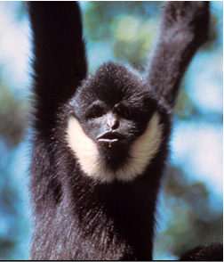
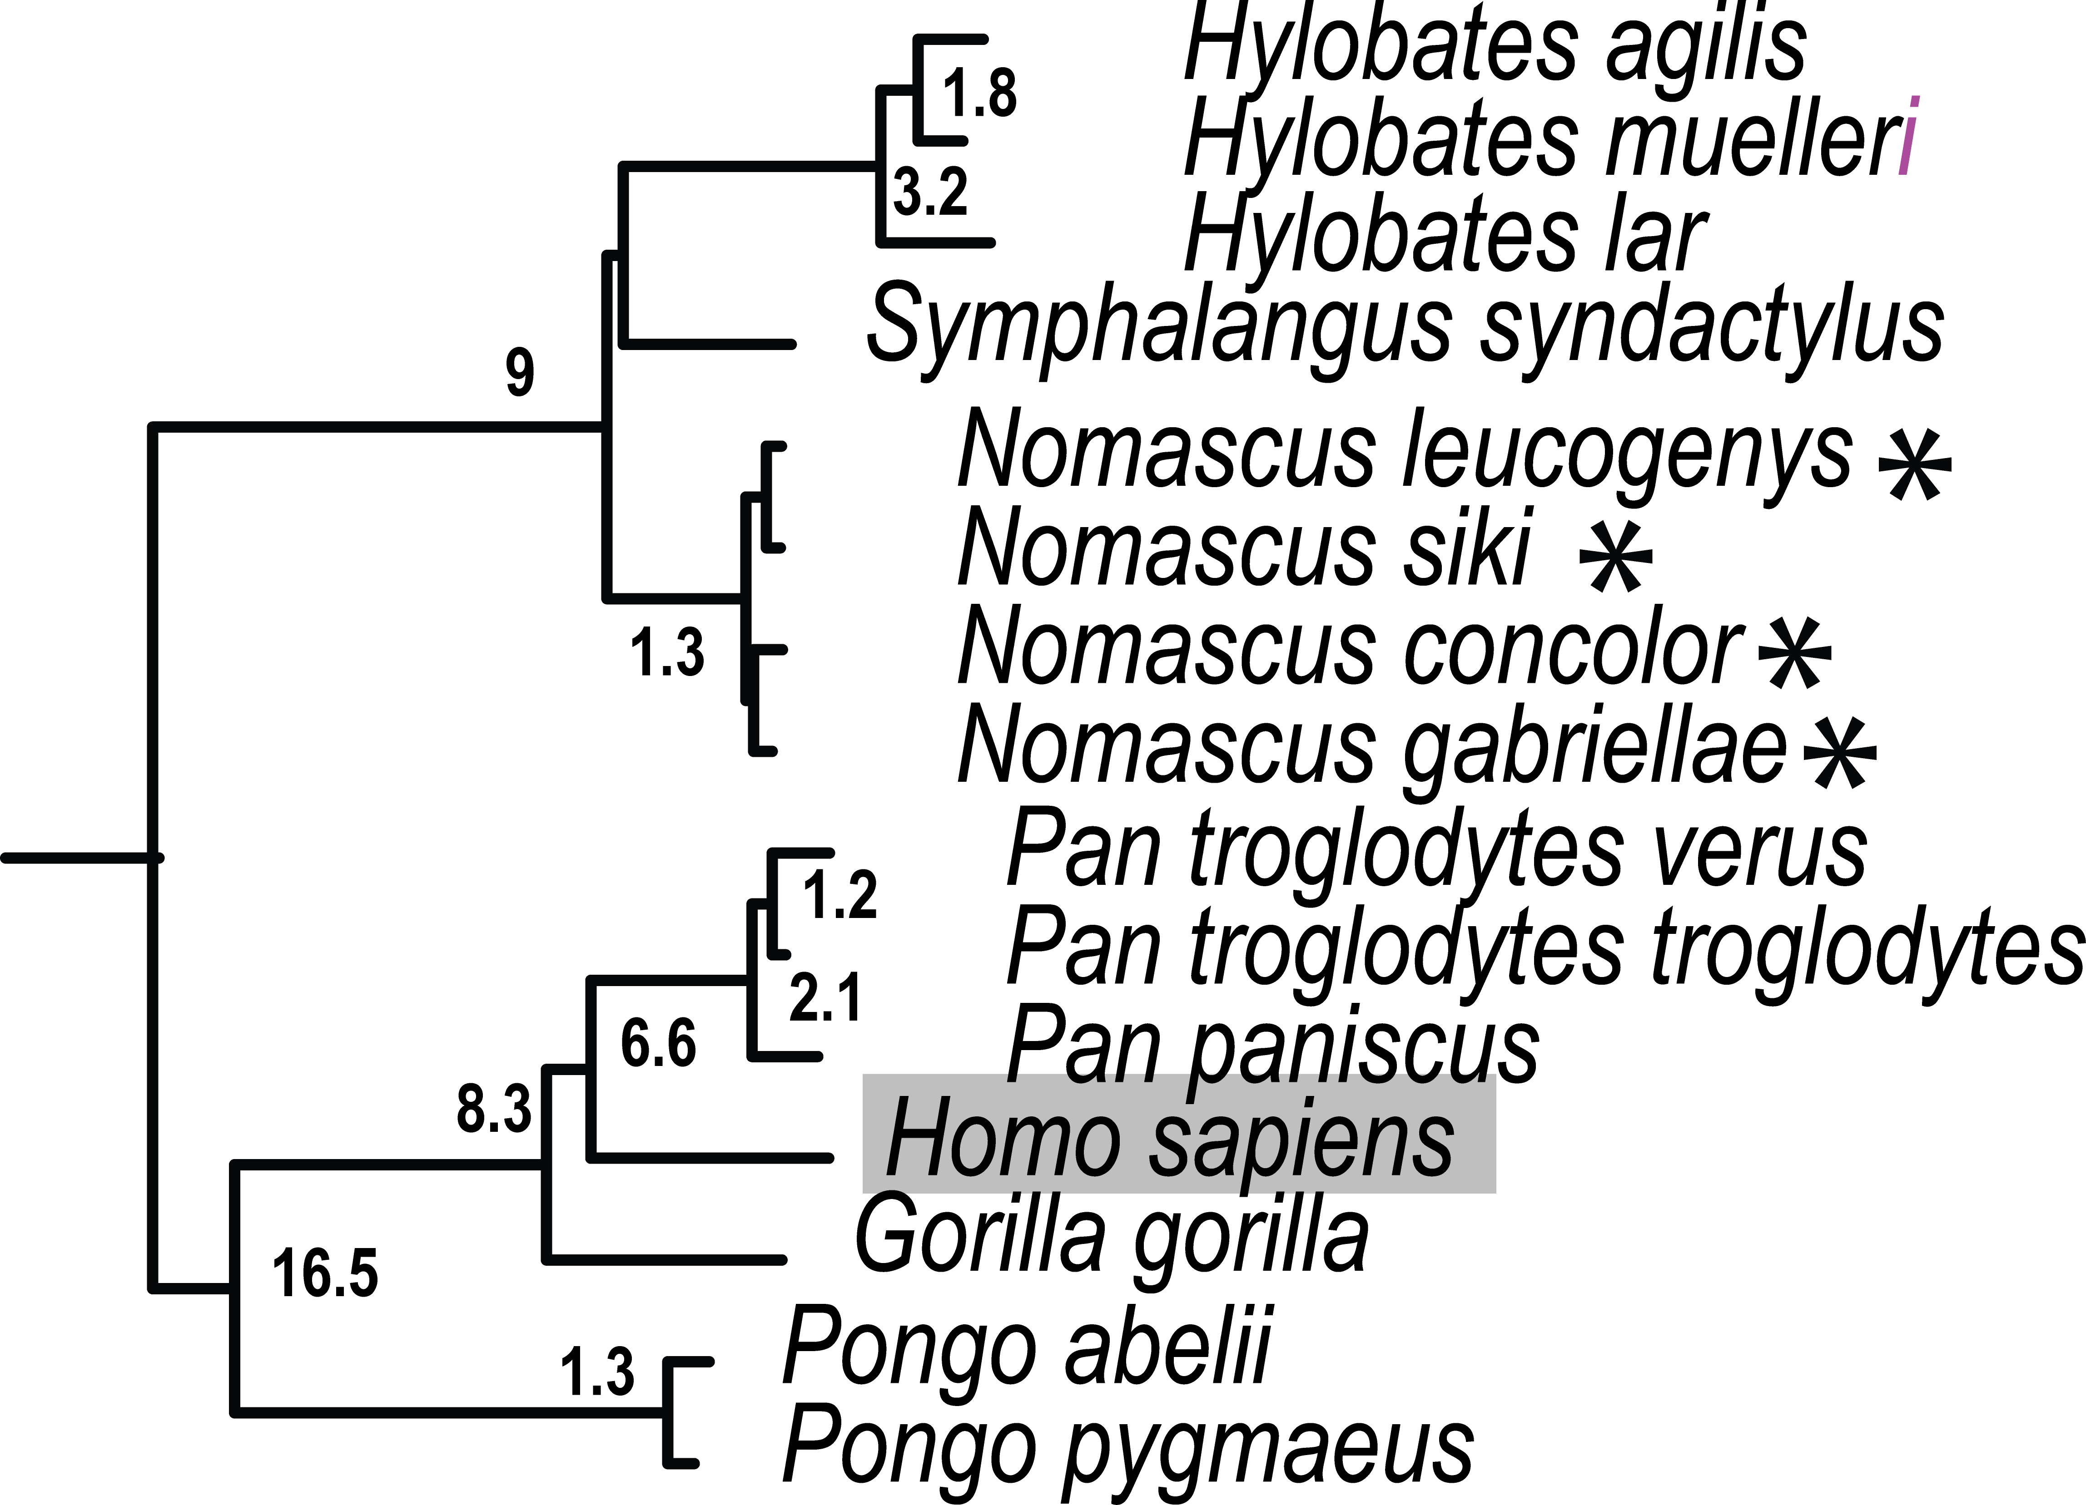
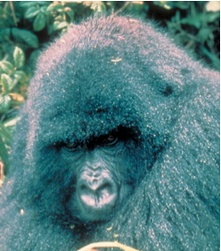
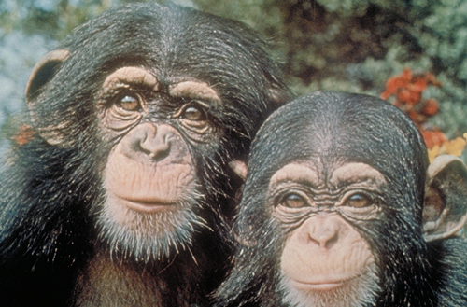
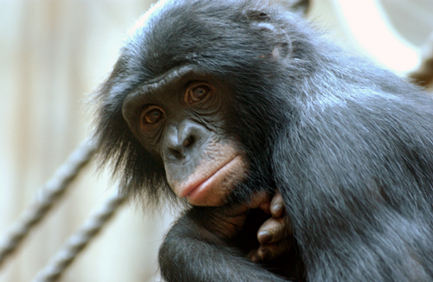
Hominoidea: Great Apes, Human, Gibbons
Hylobatidae:
Siamang, gibbon, hoolock
Exceptional rates of chromosome re-arrangement.
Each of 4 genera defined by different numbers of chromosomes.
Diverged rapidly from each other
Hominidae:
The largest primate Gorilla
Who is closest relative, Pan troglodytes or Pan paniscus?
20
Notes:
Once contentiously debated, the closest human relative of chimpanzee (Pan) within subfamily Homininae (Gorilla, Pan, Homo) is now generally undisputed. The branch forming the Homo and Pan lineage apart from Gorilla is relatively short (node 73, 27 steps MP, 0 indels) compared with that of the Pan genus (node 72, 91 steps MP, 2 indels) and suggests rapid speciation into the 3 genera occurred early in Homininae evolution. Based on 54 gene regions, Homo-Pan genetic distance range from 6.92 to 7.90 x 10-3 substitutions/site (P. paniscus and P. troglodytes, respectively), which is less than previous estimates based on large scale sequencing of specific regions such as chromosome 7 [50]. The highly endangered orangutan forms the single genus Pongo in subfamily Ponginae (nodes 75-76), the sister lineage to Homininae. Currently restricted to the islands of Borneo and Sumatra, orangutans once inhabited all of Southeast Asia during the Pleistocene [51]. Differences in behavior, morphology, karyology, and genetic data between the two island populations [2] support the taxonomic designation as two separate species of Bornean (P. pygmaeus ) and Sumatran orangutans (P. abelii), and these designations are upheld by the data presented here.
Hylobatidae (siamang, gibbons, hoolock) are noted for exceptional rates of chromosome re-arrangement [52,53], 10-20 times faster than in most mammals [54]. Classification schemes of the 12 species range from two genera (Hylobates and Symphalangus) to four subgenera and/or genera (Hylobates, Nomascus, Symphalangus, Hoolock), defined by unique numbers of chromosomes [54,55]. The eight species included in this study form three clades that coincide with genus designation (absent is Hoolock; nodes 64-69) that diverged rapidly 8.9 MYA. Moreover, Nomascus species appear more recent than Symphalangus and Hylobates, with node divergence dates estimated at less than 1 MY (Table 3, Table S9, Figure 2). Thus, Hylobatidae exhibits episodes of rapid divergence perhaps related to excessive genome re-organization and warrants additional investigation.

Slide 36
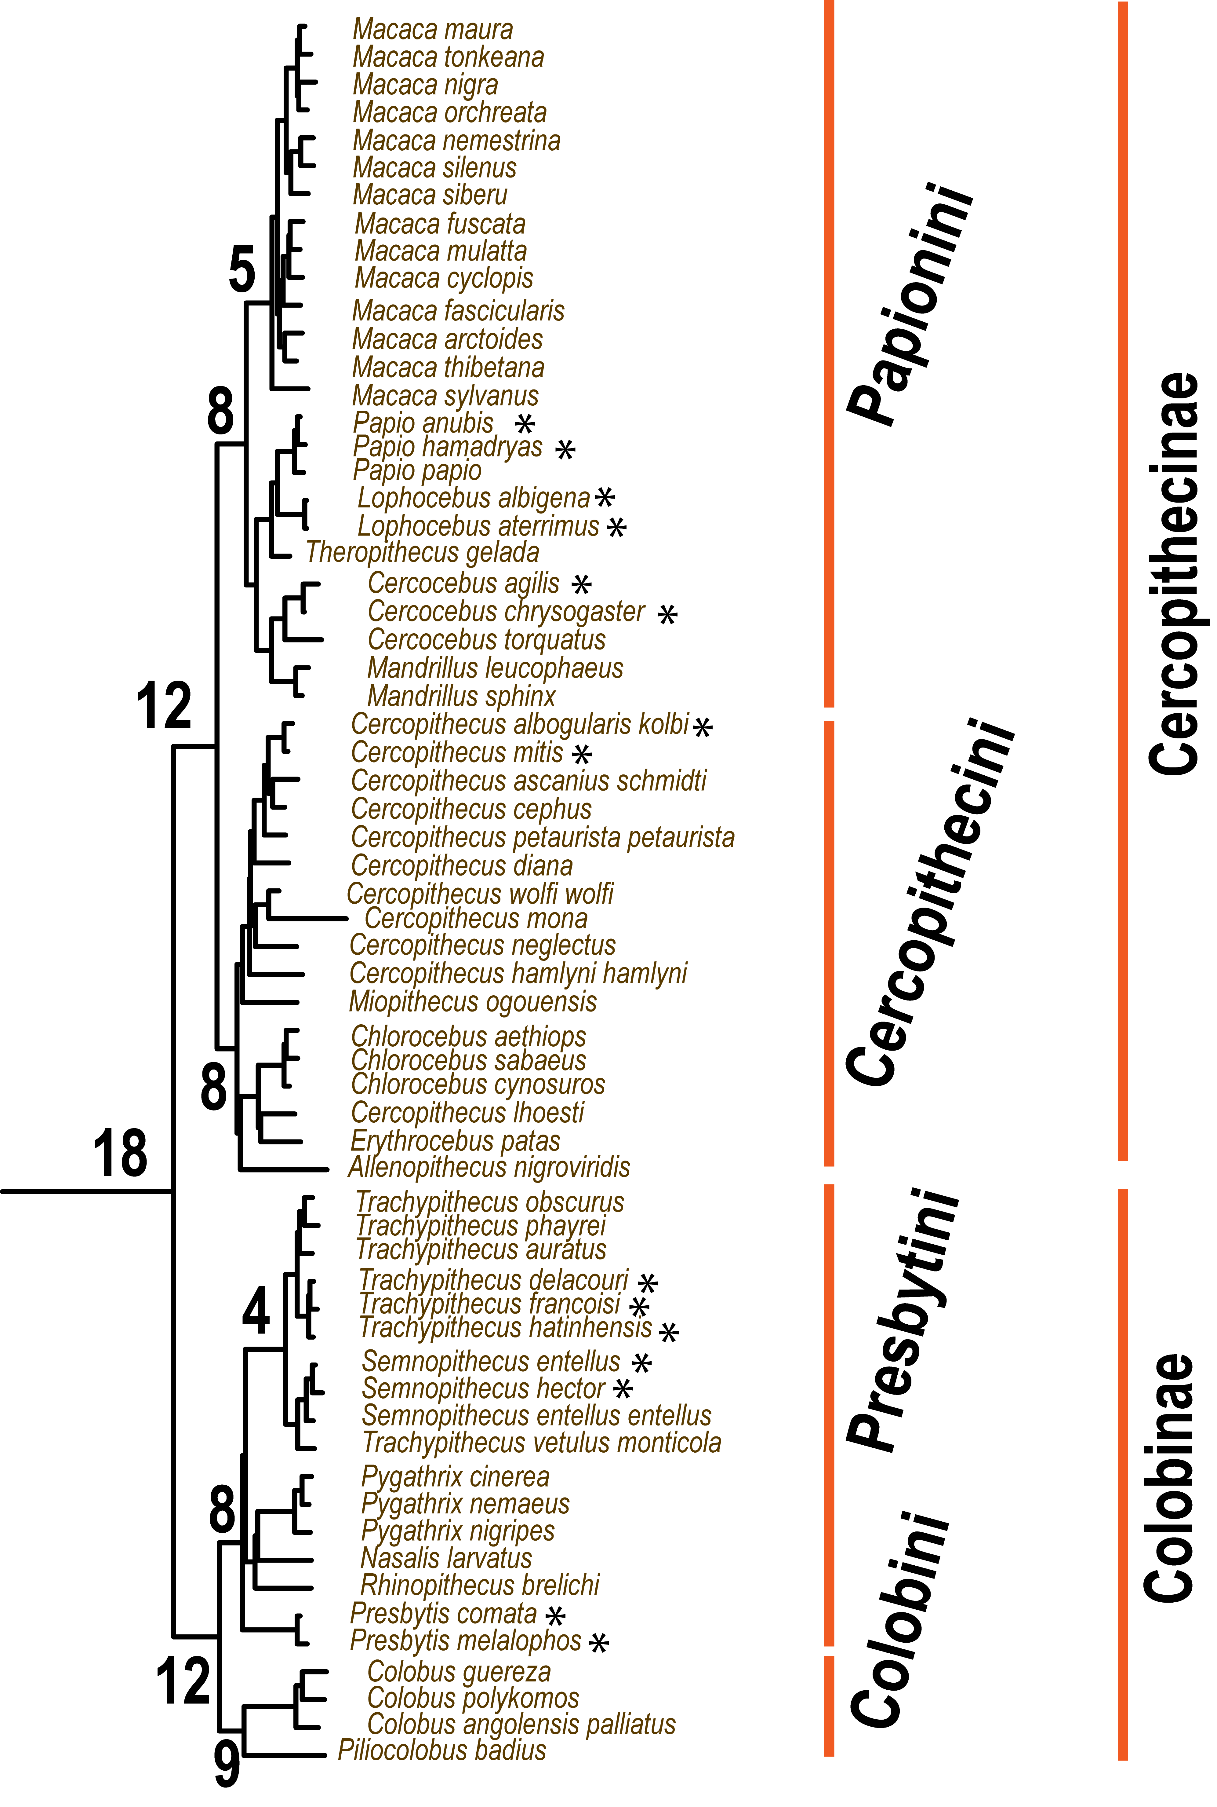
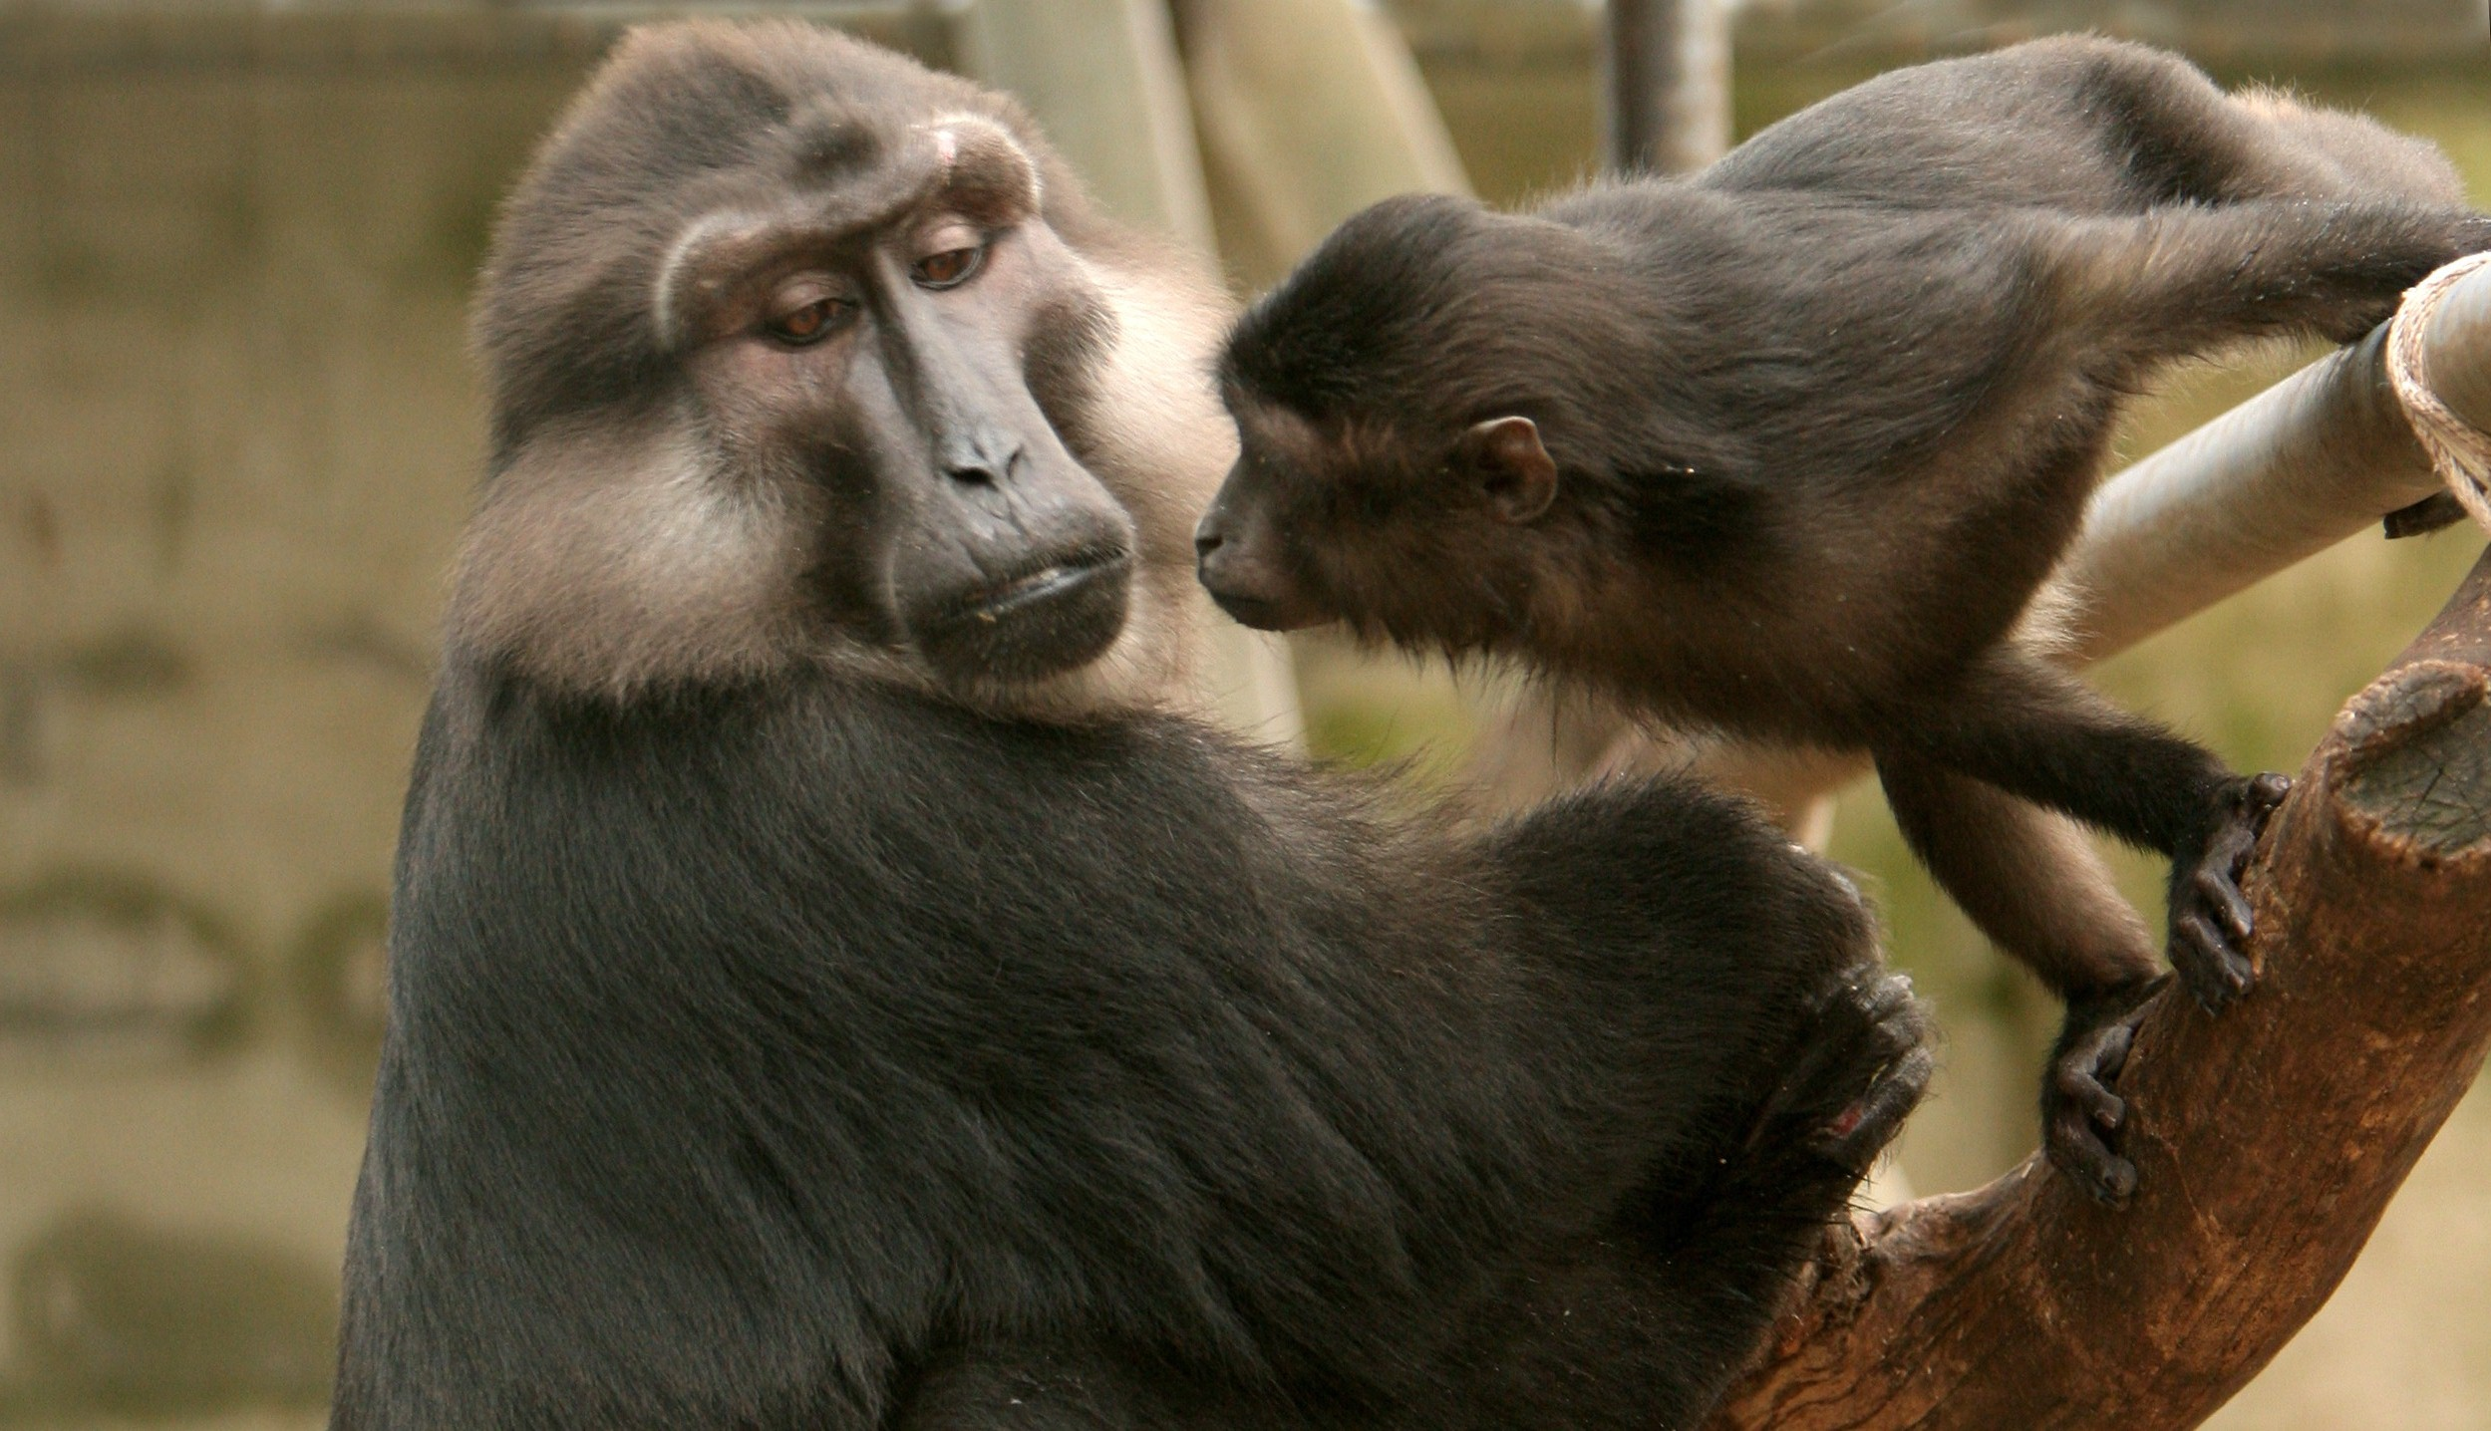
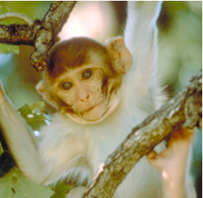


Cercopithecoidea: Old World Monkeys
Two Subfamilies
Cercopithecinae
macaques, baboons
Higher proportion of recent species (asterisk) < 1 MYA
Ongoing hybridization and introgression sympatric species
Colobinae:
Digestive adaptation to arboreal leaf eating existence
Asian and African tribes
Taxonomic revision of Trachypithecus, Presbytis, Semnopithecus
Notes:
Cercopithecoidea (family Cercopithecidae) speciation patterns are confounded by symplesiomorphic traits in morphology, behavior and reproduction, and are further confused by hybridization between sympatric species, subspecies and populations (summarized in [2]). Cercopithecidae includes two subfamilies, Colobinae and Cercopithecinae, which diverged 18 MYA (node 62), but classification schemes [2] are marked by inconsistencies between morphological [37,38] and genetic data, as well as differences among genetic data studies [4,27,39-44].
Colobinae radiation started approximately 12 MYA (node 42) with species adapted to an arboreal, leaf-eating existence. Asian (tribe Presbytini) and African (tribe Colobini) genera are monophyletic (nodes 53 and 61, respectively), supporting earlier genetic findings [4,40] over morphology-based taxonomy [2,45]. Whilst African genera Piliocolobus and Colobus are commonly recognized, the taxonomic schemes for the critically endangered Asian langur and leaf monkeys, all sharing digestive adaptations for an arboreal folivorous diet, have ranged from a single genus Presbytis to three distinct genera (Trachypithecus, Semnopithecus, Presbytis). Here, the Presbytis lineage, distinguished by 3 indel events (node 56), diverged first within Asian Colobinae, followed by the odd-nosed group (Rhinopithecus, Nasalis, Pygathrix), Trachypithecus and Semnopithecus. As odd-nosed species are not exclusively arboreal and folivorous, the results indicate either 1) morphological convergence between Presbytis with Trachypithecus and Semnopithecus, 2) adaptation for an expanded diet in the odd-nosed group, or 3) that a folivorous diet is a symplesiomorphic trait within Asian colobines.
Trachypithecus and Semnopithecus genera consist of closely related, often sympatric species (node 51), distributed in the Indian subcontinent and SE Asia, with inconsistent phylogenetic resolution among species [4,27,40,44,46]. Nonetheless, all genetic studies, including the present, place Trachypithecus vetulus (monticola) nested within the Semnopithecus clade (node 50), suggesting the need for taxonomic revision. Further, previously ambiguous associations between Trachypithecus and Semnopithecus (nodes 43-51) are clarified. Inter-specific genetic differences are roughly half those observed among other colobine genera (Figure 2, Figure S1, Table 3, Table S9) and may indicate that recent speciation, taxonomic over-splitting, reticulate evolution, or a combination thereof, (e. g. see [40,44,46]) are common within the Asian Colobinae radiation.
The remainder of Old World monkeys (tribes Papionini and Cercopithecini) [2] arose from a common ancestor approximately 11.5 MYA (node 41). Considerable interest in Cercopithecinae speciation is motivated not only by primate conservation, but increased biomedical surveillance for novel zoonotic agents and comparative research of host-pathogen adaptation relevant to the study of deadly human viral pandemics such as HIV/SIV.
Cercopithecini (guenons, patas monkey, talapoin, green monkeys) include lineages rooted by divergent monotypic genera followed by more recent speciation, characterized by transition from an arboreal to a terrestrial lifestyle. Generally arboreal, Miopithecus and Allenopithecus are early offshoots with respect to the two Cercopithecini subclades formed approximately 7 MYA. The Cercopithecus lineage (node 34) radiated after Miopithecus and retained an arboreal lifestyle. The second, rooted by Allenopithecus, forms a terrestrial clade of Erythrocebus patas and Chlorocebus species, with Cercopithecus l’hoesti separated the other Cercopithecus. This paraphyly, also reported in earlier genetic studies [39,47,48] and counter to initial morphological classifications [2], suggests taxonomic revision of Cercopithecus. Further, resolution of Allenopithecus (node 40) and Miopithecus (node 35) speciation herein suggests a single evoluiontary transition from an arboreal to a terrestrial lifestyle in E. patas, C. l’hoesti, and Chlorocebus species.
Papionini (macaques, mandrills, drills, baboons, geladas, mangabeys) is a taxonomically complex tribe [2]. One of the more familiar genera within Cercopithecoidea, Macaca (macaques) diverged 5.1 MYA and today is represented by an African lineage comprised of a single species M. sylvanus, and an Asian lineage consisting of well-defined species groups (fascicularis, sinica, mulatta, nemestrina, Sulawesi) inhabiting India and Asia, SE Asia and Sundaland [49]. With the exception of the fascicularis group, which is split in this study whereby M. arctoides [fascicularis] is more closely aligned with M. thibetana [sinica] rather than M. fascicularis as expected, our data otherwise strongly support these macaque species groups (nodes 6, 11). Moreover, the phylogeny affirms Groves [2] proposal that Lophocebus and Theropithecus are distinct clades apart from Papio (nodes 18, 19), although the average nucleotide divergence among these three genera are generally less than between other recognized Papionin genera (Macaca, Mandrillus, Cercocebus) (Figure 2, Figure S1, Table 3, Table S9). Lastly, sequence divergence between tribes is unequal with Cercopithecini nearly twice that of Papionini (mean branch length = 13.1, 7.43, respectively, p<0.005) and there are numerous instances of discordance between the present phylogeny with previous mtDNA studies [4,5] suggesting that continued resolution of Cercopithecinae speciation and of Papionini in particular, will likely include evidence of reticulate evolution represented by ongoing and historic episodes of hybridization (e.g. see [39,48]).

Slide 37
The Next Phase for Primate Phylogenomics
Chromosome evolution and genome rearrangement
Adaptive Evolution of Targeted Genes
Whole genome and Mitochondrial Genome Sequence
New Technologies-RNA and Exon Sequence
Cognitive and Brain development
Development of Vision
Morphological traits
Reproductive traits
Development of dentition
Behavioral Evolution & Ecology
Genetics of Longevity and Mortality
Genes in Immunology and disease Resistance
Characterization of Novel Pathogens & Agents of Infectious Disease
Endogenous retroviruses, Repetitive and Satellite DNA Evolution
Phylogenetic reconstruction of specific lineages
Bayesian methods of phylogenetic reconstruction and dating
Rates of Evolution Among Lineages and Species
Biogeography, Speciation & Hybridization
Taxonomic Revision Genera, Species and Subspecies
Conservation management of endangered species
Human Anthropology
Human Biomedicine
Notes:
Here I summarize the categories of research publications that have used our phylogeny in their own areas of scientific inquiry. You can see that the topics are quite braod, ranging from chromosome evolution to behavior to human biomedicine. It indicates that the primate order holds great promise in being a rich resource for mutliple fields of science.

Slide 39
Mapping to Human (HG19)
Notes:
Average read length is >200bp with each sample.
Sequence quality is high, all 10 species have >91% base call qualities >Q30 (the term for the % of base call accuracy >99.9%) for both reads
Reads mapped to human hg19 performed as expected with evolutionary time. The highest mapped reads of 99% occurred with bonobo chimp and the lowest of 68% occurred with lemur. The unmapped reads will be annotated for gene content for each species.
The percent uniqueness (the % of aligned reads with non-redundant start coordinates) ranges between species with least in gibbon (52%) and the most in colobus monkey (90%).

